Slide 1
West Midlands
Sustainability and Transformation: Development and next steps
November 2017

Slide 2
Achieving the 5YFV vision – the triple aim
For the NHS to meet the needs of future patients in a sustainable way, we need to close all three of these gaps:
Health & Wellbeing Gap
Radical upgrade in prevention
National action required on major health risks such as smoking, drinking and obesity
Targeted prevention initiatives e.g. diabetes
Much greater patient awareness
Harnessing the ‘renewable energy’ of communities
1
Care & Quality Gap
New Care Models + new support
Defining and measuring quality and tackling unwarranted variation
A menu of New Care Models for local areas to consider, backed by investment and flexibility in implementation
New whole systems intervention regimes to transform local health economies and raise standards
2
Funding and Efficiency Gap
Efficiency & investment
Action required on three fronts: demand, efficiency and funding
Action on prevention and care could deliver significant efficiency gains
The Government has committed to an additional £8.4bn in funding by 2020/21 and, with this investment and implementation of new care models we believe that we could close the known finance gap
3

Slide 3
FYFV Next Steps: Priorities and Planning
Urgent and emergency care plan
General practice investment and transformation
Cancer pathway improvements
Mental health transformation program
10 point efficiency plan
DTOC, medicines, avoidable demand, corporate overhead reduction, financial accountability, temp staffing, procurement, clinical variation, estates, income.

Slide 4
Priorities by population
Tier 1
Priorities
National / Regional: Region
Tier 2
Priorities
Sub Regional:
West Midlands,
Combined Authority ?
Tier 3
Priorities
Health Economy:
Birmingham, Arden, Black
Country, Herefordshire /
Worcestershire
Tier 4
CCG: Locality

Slide 5
Sustainability & Transformation Partnerships (STPs)
Making the transition to population based integrated health & care systems.
STPs are not new statutory bodies. It’s a case of ‘both the organisation and our partners’, as against ‘either/or’.
The way STPs work will vary according to the needs of different parts of the country.
Success will be measured by effectiveness in tackling the triple aim gaps.
This approach to health and social care integration, building on the Better Care Fund, is also supported by government

Slide 6
Accountable Care Systems – evolved STPs
Expectations
Agree an accountable performance contract that is credible
Together manage funding for their defined population, committing to shared performance goals and a financial system ‘control total’ across CCGs and providers
Create an effective collective decision making and governance structure, aligning the ongoing and continuing individual statutory accountabilities of their constituent bodies.
Demonstrate how their provider organisations will operate on a horizontally integrated basis- hospital networks
Demonstrate how they will simultaneously also operate as a vertically integrated care system, partnering with local GP practices formed into clinical hubs serving 30,000-50,000 populations. In every case this will also mean a new relationship with local community and mental health providers as well as health and mental health providers and social services.
Deploy (or partner with third party experts to access) rigorous and validated population health management capabilities
Protect patient choice, deploy personal health budgets

Slide 7
AC System to AC Organisation
‘’In time some ACSs may lead to the establishment of an accountable care organisation. This is where the commissioners in that area have a contract with a single organisation for the great majority of health and care services and for population health in the area. A few areas (particularly some of the MCP and PACS vanguards) in England are on the road to establishing an ACO, but this takes several years.
The complexity of the procurement process needed, and the requirements for systematic evaluation (ISAP) and management of risk, means they will not be the focus of activity in most areas over the next few years.’’
Strategic Commissioning
Becoming strategic commissioners for each STP
Means taking on some of the functions from NHSE on planning and assurance
Means delegating some of the functions to the provider to manage pathways

Slide 8
Mature state
Oversight and Specialised Commissioning Functions
(Exercising oversight functions over the system
NHSE, NHSI and CQC devolve functions to this level)
Strategic Commissioner
(Integrated NHS and Local Authority functions serving larger populations)
Acute Care Collaborations
Acute Care Collaborations
Oversight and scrutiny
Joint commissioning
Integrated Primary & Community Care & Support Provider
Local Authority
Other providers
Oversight and scrutiny
Please Note: Document classification is not to be removed.

Slide 9
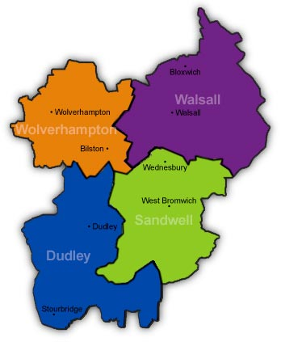
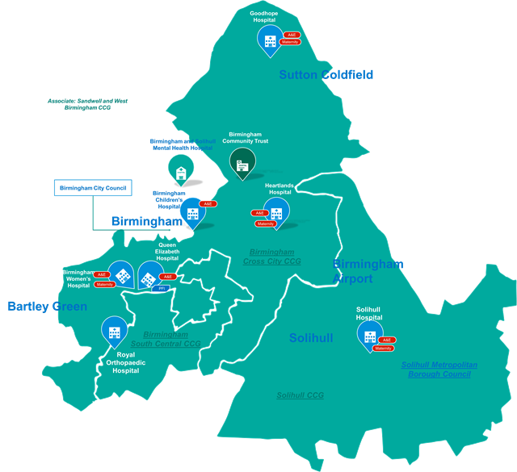
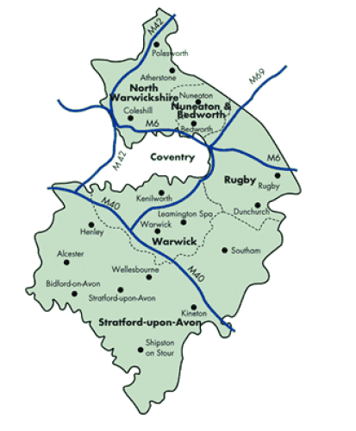
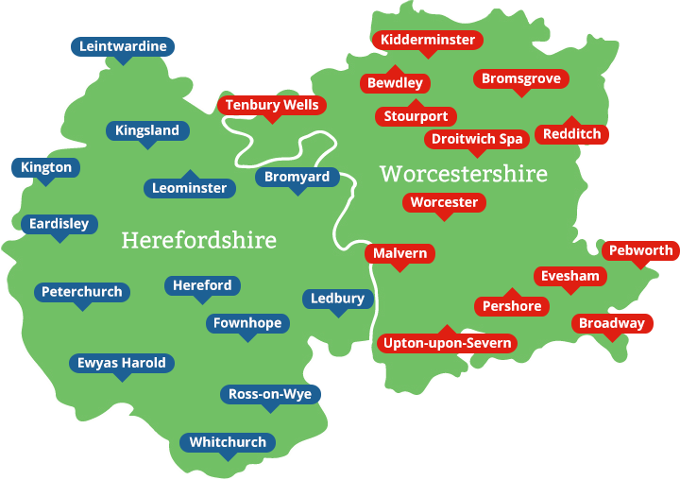
Joint Strategic
Commissioning
4
From 14 to 4, plus 1
Joint Strategic
Commissioning
3
tbc
Provider accountable
care ACO(’s )
Provider accountable
care ACO(’s )
Provider accountable
care ACO(’s )
tbc
tbc
West Midlands
Commissioner
3
tbc
Joint Strategic
Commissioning
Provider accountable
care ACO(’s )
4
Joint Strategic
Commissioning

Slide 10
Birmingham and Solihull STP
CCGs:
NHS Birmingham South and Central: Pop 205.6k
NHS Solihull: 211.4k
NHS Birmingham Cross City: 743.3k
Total Population: 1,160.3k
Urgent and Emergency Care Network: West Midlands
System Resilience Group:
Birmingham and Solihull
Birmingham Children’s
Providers:
Acute
Birmingham Children's Hospital NHS FT
Birmingham Women's NHS FT
Heart of England NHS FT
The Royal Orthopaedic Hospital NHS FT
University Hospitals Birmingham NHS FT
Community
Birmingham Community Healthcare NHS Trust
Mental Health
Birmingham & Solihull Mental Health NHS FT
Ambulance
West Midlands Ambulance Service NHS FT
Local Government:
Birmingham City Council
Solihull Metropolitan Council
Transformation and Vanguards:
HEFT – Surgical reconfiguration (Paused)
West Midlands NICU review
BSBC Stroke Review
Solihull UEC Vanguard
MERIT –Mental Health Provider Collaboration Vanguard

Slide 11
Herefordshire and Worcestershire STP
CCGs:
NHS Herefordshire: 188.7k
NHS Redditch and Bromsgrove: 181.3k
NHS South Worcestershire: 296.6k
NHS Wyre Forest: 98.6k
Total Population: 765.2k
Urgent and Emergency Care Network: West Midlands
System Resilience Groups:
Worcestershire
Herefordshire
Providers:
Acute
Worcestershire Acute Hospitals NHS Trust
Wye Valley NHS Trust (Acute and Community)
Community
Worcestershire Health and Care NHS Trust (Community and Mental Health)
Mental Health
2gether NHS FT
Ambulance
West Midlands Ambulance Service NHS FT
Local Government:
Worcestershire County Council
Herefordshire Council
Transformation and Vanguards:
Future of Acute Hospitals in Worcestershire
West Midlands NICU
Connecting care
One Herefordshire

Slide 12
Coventry and Warwickshire STP
CCGs:
NHS Coventry and Rugby: 445.5k
NHS Warwickshire North: 191.2k
NHS South Warwickshire: 263.8k
Total Population: 900.5k
Urgent and Emergency Care Network: West Midlands
System Resilience Groups:
Coventry and Rugby
South Warwickshire
Warwickshire North
Providers:
Acute
George Eliot Hospital NHS Trust
South Warwickshire NHS FT (Acute & Community)
University Hospitals Coventry and Warwickshire NHS Trust
Mental Health
Coventry and Warwickshire Partnership NHS Trust (Mental Health & Community)
Ambulance
West Midlands Ambulance Service NHS FT
Local Government :
Warwickshire County Council
Coventry City Council
Transformation and Vanguards:
West Midlands NICU review

Slide 13
West Birmingham and Black Country STP
CCGs:
NHS Dudley: 316.4k
NHS Sandwell and West Birmingham: 492k
NHS Walsall: 276.2k
NHS Wolverhampton: 253.8k
Total Population: 1,338.4k
Urgent and Emergency Care Network: West Midlands
System Resilience Groups:
Dudley
Walsall
Wolverhampton
Sandwell and West Birmingham
Providers:
Acute
Sandwell and West Birmingham Hospitals NHS Trust
The Dudley Group NHS FT (Acute & Community)
The Royal Wolverhampton NHS Trust (Acute & Community)
Walsall Healthcare NHS Trust (Acute & Community)
Community
Birmingham Community Healthcare NHS Trust
Black Country Partnership NHS FT
Mental Health
Birmingham and Solihull Mental Health NHS FT
Dudley and Walsall Mental Health Partnership NHS Trust
Ambulance
West Midlands Ambulance Service NHS FT
Local Authorities:
Birmingham City Council
Dudley Metropolitan Council
Sandwell Metropolitan Council
Walsall Council
Wolverhampton City Council
Transformation and Vanguards:
West Midlands NICU
Stroke Review
Dudley MCP
Modality MCP
MERIT – Mental Health Collaboration

Slide 14
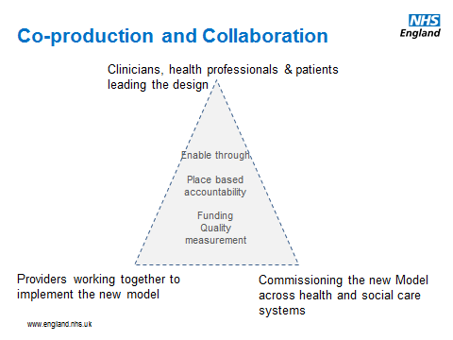
Scale of challenge requires a new leadership approach

Slide 15
What are the key questions to ask in your STP
This is a joint leadership approach, how are key stakeholders being engaged?
The STP is ‘owned’ by partners and single plan for the system. Health and social care, how are local authorities involved?
Is the STP governance clear with right engagement?
Have you engaged in a vision and priority setting based on evidence of triple aim?
Is there clear project arrangements to execute the plan development – e.g. clinical, financial?
Are you keeping key stakeholders in the loop going forward?

