Slide 1
Getting your voice heard: ICSs, STPs and Clinical Engagement
Tom Bramwell – tbramwell@bma.org.uk

Slide 2
Introduction
The state of integration
Where PCNs fit
‘Getting your voice heard’
What the BMA is doing

Slide 3
BMA View – at a glance
BMA View
The BMA supports the aim of integrating health and social care, and the creation of long-term local plans for the NHS
However, we have had concerns about how that integration has been pursued
Notably around resources, governance, clinical engagement, variation & risk to patients
We were critical of STPs at launch and oppose the ICP contract
ICSs present both opportunities and challenges, so its vital that we monitor them and hold them to account

Slide 4
BMA principles for integration
If any model of integration is to be successful, it must:
ensure the pay and conditions of all NHS staff are fully protected
protect the partnership model of general practice and GPs’ independent contractor status
only be pursued with demonstrable engagement with frontline clinicians and the public, and must allow local stakeholders to meaningfully and constructively challenge plans
be given proper funding and time to develop, with patient care and the integration of services prioritised ahead of financial imperatives and savings
be operated by NHS and publicly accountable bodies, free from competition and privatisation

Slide 5
The state of integration
STPs have gradually evolved, focusing on organising services as well as planning
This has led to the introduction of more advanced models – namely the ICS (integrated care system) and the ICP (Independent Care Provider) Contract
Long Term Plan: every STP to become an ICS by 2021
PCNs are seen as a core element of ICSs and the wider agenda

Slide 6
The state of integration: Long Term Plan
The Long Term Plan for the NHS has set out NHSE’s vision for the future
This revolves around integration and the development of ICSs
Includes the development of Primary Care Networks (PCNs)
Backed up, in part, with additional funding: by 2023/24, funding for primary and community care will be at least £4.5 billion higher than in 2019/20
Also establishes wider, longer term goals around prevention, public health
Each STP and ICS has also been tasked with to producing a new five year plan by November 2019 – now expected December at the earliest

Slide 7
The state of integration: Commissioning
LTP set out a goal to ‘streamline’ commissioning –reducing the number of CCGs
Broad expectation for there to be a one CCG for each STP/ICS
Accelerated by NHSE, through financial pressure and changes to guidance
Presents a number of possible challenges, including:
Continuity of funding and support for practices
Reduced influence for GPs, PCNs, LMCs and others?
Accountability

Slide 8
The state of integration: STPs to ICSs
STP
ICS
ICP Contract?

Slide 9
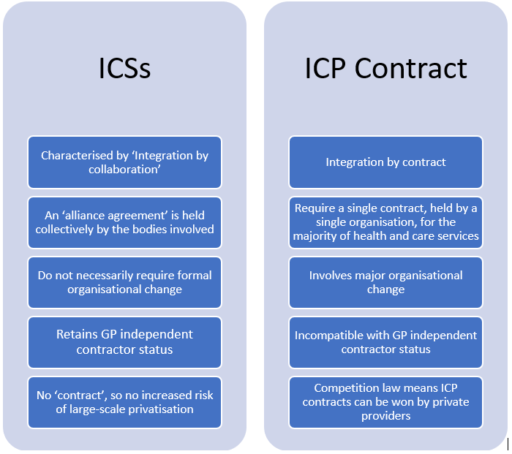
ICSs v the ICP Contract
There are fundamental differences between them
But the ICSs and the ICP Contract have often been conflated

Slide 10
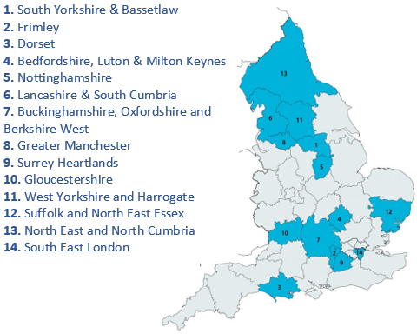
ICSs: where and what
Currently 14 ICSs – covering approx. 21 million people
Vary in size, composition, and approach
Systems take on collective responsibility for:
managing resources
delivering NHS standards
improving population health

Slide 11
ICSs: structure
System
Places
Localities
1m+ population
Manage system-wide performance, finances, regulation
Also cover workforce planning, system transformation, strategic commissioning
250 – 500k population (based around cities, towns)
Planning of localised services – including secondary and community care
Integration of NHS and Local Authority services
50k+ population (based around PCNs)
General practice and primary care delivery
Multi-disciplinary teams: health and care professionals working together

Slide 12
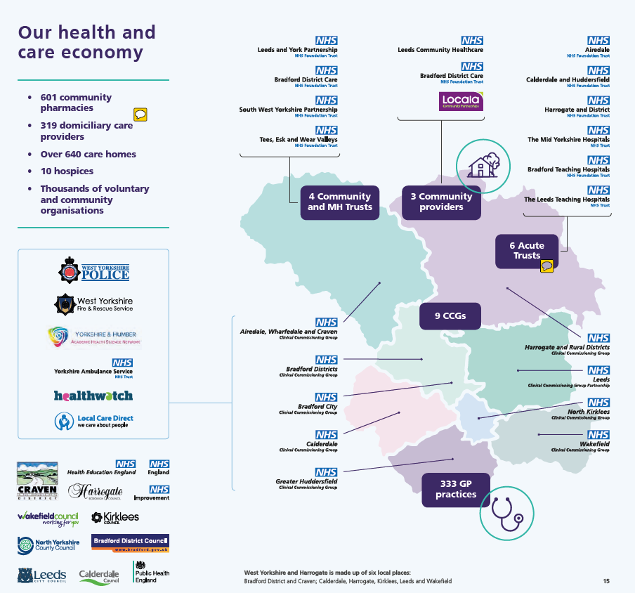
ICSs/STPs: What the system (can) look like
West Yorkshire and Harrogate ICS
8 ‘places’
8 LAs
9 CCGs (for now)
6 Acute Trusts
4 Community and MH Trusts
3 Community Providers
333 GP practices
601 Community pharmacies
10 Hospices
640+ Care homes

Slide 13
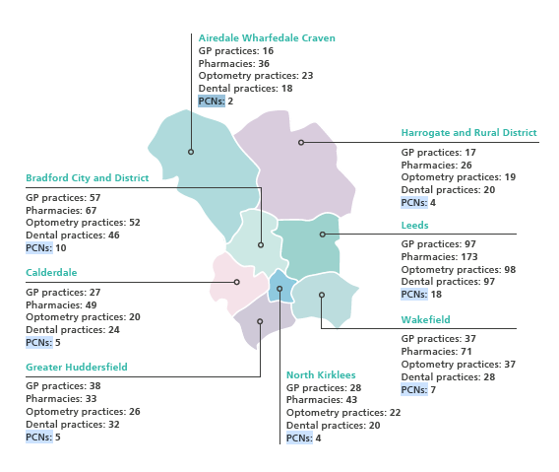
ICSs/STPs: What primary care (can) look like
West Yorkshire and Harrogate ICS
55 PCNs
55 Clinical Directors
317 GP practices
498 Pharmacies
285 Dental practices

Slide 14
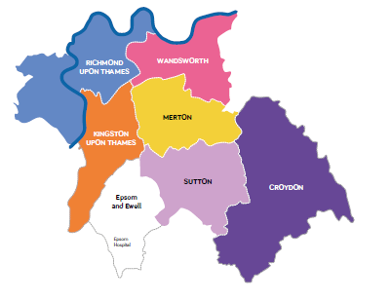
ICSs/STPs : What they (can) look like
South West London STP
7 ‘places’
6 LAs
6 CCGs
8 Acute and community Trusts
2 MH Trusts
39 PCNs
39 Clinical Directors
6 GP Federations
138 GP practices

Slide 15
Why ICSs matter
Service reconfiguration
A number of systems are pursuing changes to the way services are structured, including the possibility of trust mergers, hospital reclassifications, and concentrating specialities - such as stroke care - in single sites
Changing care pathways
Systems are frequently looking to revise care pathways – particularly in areas such as MSK (musculoskeletal) and stroke care - and often look to local clinicians to lead these processes
Finances and funding
ICSs and STPs are now expected to take on greater responsibility for the collective financial performance of their system, including long-term planning and the management of shared ‘system control totals’
Workforce planning
Systems are gradually taking a lead on workforce planning and management, including training and recruitment – not just of doctors, but also other clinical and non-clinical staff and MAPs

Slide 16
Why ICSs matter cont’d
Passporting and ways of working
Doctors will more frequently work as part of wider, multi-disciplinary teams and in different settings, and under different employment models
Leadership and training
Some systems are looking to train local doctors to support these changes in new leadership roles, across branches of practice, with various leadership academies and programmes emerging
Public and population health
ICSs and STPs are focusing on long-term population health and prevention, partly as a way of reducing demand on services, involving significant co-operation with local authorities
Data, technology, and innovation
The use of data and technology is increasingly important for systems, many of which are looking to pool data sources – including creating shared care records, predicting poor health, and making IT systems interoperable

Slide 17
Where PCNs fit
PCNs are seen as a building block of ICSs
The basis of primary care provision
The basis of the ‘neighbourhood’ level
70–90% of work within an ICS expected to occur at the place and neighbourhood levels
Major interface between health and care services, as well as Local Authorities, is expected to take place at this level
Likely where there will be the most ‘integration in action’, with MDTs etc
Vital that PCNs are able to meaningfully engage with the STP/ICS at all levels

Slide 18
Where PCNs fit: governance
ICSs/STPs are required to have:
a partnership board drawn from commissioners, providers, PCNs (primary care networks), local authorities, and third sector organisations within the ICS
named accountable clinical directors for each PCN within the ICS, to facilitate proper engagement with GPs
a named lead, at director level, for PCN development who is tasked with proactively engaging with PCN CDs
Likewise, the PCN CD role includes:
representing the PCN at CCG, ICS and STP-level clinical meetings
contributing to strategy development and the wider work of the ICS

Slide 19
Where PCNs fit: support from ICSs
ICSs are also expected to provide a range of support to PCNs, specifically for:
PCN set-up support
Organisation development and change
Leadership development support
Supporting collaborative working in multi-disciplinary teams
Population health management
Social prescribing and community development
ICSs are also expected to provide dedicated support for CDs
Reports from PCNs and CDs indicate that this support is not reaching them uniformly

Slide 20
Getting your voice heard: our guidance
This November we published new guidance for BMA members to support them in engaging with their local health and care systems
Provides advice, tips, and practical tools to help grassroots members and frontline doctors to contact their STP/ICS leaders
This includes a breakdown of contacts for each system
As well a range of suggested questions about what is in a system’s plan – depending on a doctor’s interests and branch of practice
Encouraged members and regional structures to contact their STPs/ICSs

Slide 21
Getting your voice heard: tips and advice
Write to / contact ICS/STP leaders directly
Invite senior managers to explain local integration plans as it affects you at LMC meetings and events
Raise with local BMA staff, Regional Councils
Attend public consultation meetings and respond to consultations
Raise key issues and developments with national staff
PCNs carry weight – which in combination with LMCs can bring people to the table

Slide 22
How to engage: suggested questions
How will PCN (Primary Care Network) Clinical Directors be involved in the system’s work?
What steps will the STP/ICS be taking to protect health budgets, including in the event of any pooling of health and care budgets?
What assessment has the STP/ICS made of the condition and quality of NHS estates across the system? Has it produced a Strategic Estates Plan?
What specific plans are in place for GP recruitment and retention?
How are frontline clinicians being involved in the system’s work?
Does the STP/ICS have, or plan to launch, a clinical senate or other forum for clinicians to collaborate and communicate?

Slide 23
Where to engage: many moving parts
Huge amount of activity within and ICS or STP
Many different ‘moving parts’ and levers that can be pulled
Not just a question of representation and influence at the top, but throughout
Activity at Place and Locality more easily directed and can shape wider plans
Leadership/training opportunities throughout
System
Place
Locality

Slide 24
Where to engage: many moving parts
Also means PCNs need to co-operate in their lobbying
Large STPs will have a substantial number PCNs and CDs – there won’t necessarily be space for all at the top
Need to co-ordinate messaging and priorities between CDs
Also should look at other points / places for CDs to sit – i.e. at place level, within care pathways, work streams etc
But, obviously CDs need the time and resource to do this – onus should not only be on them
STPs and ICSs should proactively and actively seek the input of CDs, PCNs, and LMCs

Slide 25
Where to engage: many moving parts
West Yorkshire and Harrogate ICS
8 ‘places’
8 LAs
9 CCGs (for now)
6 Acute Trusts
4 Community and MH Trusts
3 Community Providers
333 GP practices
601 Community pharmacies
10 Hospices
640+ Care homes

Slide 26
BMA support offer
PCN community
PCN conference
Learning and development
Career coaching
Legal services
Insurance services
HR and employment law advice (members only)

Slide 27
BMA work
Getting your voice heard: a guide to influencing and engaging with changes to your local health system
BMA briefing: Integrated Care Systems
How to influence change in the NHS
The Primary Care Network Handbook
BMA PCN Webpages

