Slide 1
Our Integration Journey
May 2018
Sultan Mahmud- Director of Integration
Sultan Mahmud-
Director of Integration
s.mahmud@nhs.net

Slide 2
Contents
Overview of RWT
RWT Primary Care Journey
Integrated Data
Forward Look
Questions

Slide 3
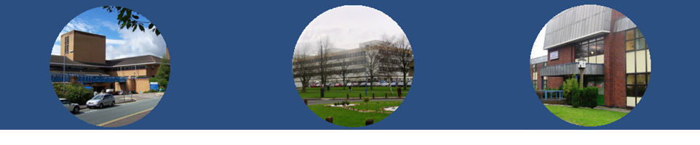
RWT context
Provider of Acute, Community and Primary Care Services - £550m
A culture of innovation is a common thread in our delivery
The need to create capacity for specialist services requires us to engage meaningfully in service redesign
Financially stable and strong CCG
Strong local authority
Leadership, stability and a track record of delivery

Slide 4

A culture of Innovation
Teletracking- Lord Carter Prize for Innovation- 2017
Safe Hands RFID System- the most advanced in the world
AIM Clinical Fellows Programme
Vertical Integration
Consultant and Registrar in Public Health –embedded in clinical teams
One of nine Gastroenterology training centres in the UK
WM Clinical Research Network host- the best performing in England
Physician A, Care of the Elderly Consultant in-reach into A&E and CDU and Admission Avoidance Team
Theatre Productivity
7 Day Services pilot site
State of the art Pathology Hub for the Black Country
Stroke
Frailty
Artificial Intelligence for – HR/Finance
Robotic Surgery
TAVI

Slide 5
Real-Time Technology Tracking of Beds, Staff and Assets
Breaches due to unavailability of beds have reduced by ~40% since the patient flow system went live
Cancelled operations due to bed unavailability has also decreased by ~ 70% this year
Bed turnaround time for a bed once a patient is discharged is 32 mins

Slide 6

Clinical Fellows Programme
Developed conjunction with the Academic Institute of Medicine (AIM) at the University of Wolverhampton for middle grade doctors.
Mutual benefit model to improve the NHS efficiency and quality and to develop the individual medical practitioner
Fellows of the programme, work towards attaining a MSc in Clinical Medicine as well as delivering clinical services at the Trust in a structured portfolio work plan
In times of increasing volumes of complex work at a time of resource constraint and staff shortages-The Trust’s use of locums in general medicine has largely stopped
Programme is being extended to general practice

Slide 7
Why Integration for RWT?
Position 1 – Retreat to Fortress Mentality in wake of service and financial pressures- trade out of trouble!
Position 2- Work with local partners to provide co-ordinated care through collaboration, vertical and horizontal integration and ensure sustainability. General Practice is the cornerstone in our integration plans.
Position 3- Build on co-ordinated care and focus on improving the broader health of the population

Slide 8
Why Vertical Integration for GPs?
Integrated Care Delivery – but with support
GP working hours longest in a generation- 40% Increase in consultations!!
Primary Care Funding
Record numbers of GPs retiring or leaving the profession
National drive for Primary Care at Scale
Back Office Support to aid RESILIENCE
Enhanced personal and professional development
Novel Contractual Model- Working for the NHS
Good Financial Package

Slide 9

RWT VI went live on 1 June 2016 -
Started with five practice sites and a population base of circa [23,500] patients
NHSE (WM) Clinically Assured Process
Significant national interest
VI growth – 77k population base & growing

Slide 10
Novel GMS Subcontracting approach
GPs and Practice Staff become NHS employees
CQC registration with the Trust
GMS contract holder/RWT Joint Accountability
Practices remain active members of the CCG

Slide 11

Scorecard – Since June 2016

Slide 13

Click on link below
https://youtu.be/hWgFslq8rOY

Slide 14
Features of Integrated Care
Information Continuity- Patients’ clinically relevant information is available to all providers at the point of care and to patients through electronic health record systems
Care Coordination and Transitions- Patient care is coordinated among multiple providers, and transitions across care settings are actively managed.
Continuous Innovation -The system is continuously innovating and learning in order to improve the quality, value, and patient experiences of health care delivery.
Easy Access to Appropriate Care -Patients have easy access to appropriate care and information at all hours, there are multiple points of entry to the system, and providers are culturally competent and responsive to patients’ needs.
Peer Review and Teamwork for High-Value Care Providers (including nurses and other members of care teams) both within and across settings have accountability to each other, review each other’s work, and collaborate to reliably deliver high-quality, high-value care
System Accountability There is clear accountability for the total care of patients.
Informatics

Slide 15
What GPs asked for……
Live Pushed Data- Information to do the right thing for patients
Risk Stratification tool 2 months out of date
Capturing the whole patient journey
Access to Live Trust Data
Issues with Coding i.e. EMIS has asthma – Aristotle Missing
Co-Design
Actionable information/Insight
Enhancements in Quality and Safety alerting
Access to Live Trust Data
Wanted Patient’s overall Journey across the NHS
MDT Support
More Involvement in Discharge Planning

Slide 16

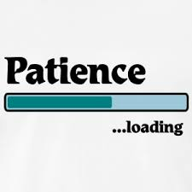


INTEGRATED DATA SYSTEM

Slide 17
Click on link for
Video of The Integrated Data System in use
https://youtu.be/ny3g6yAFb4E

Slide 18
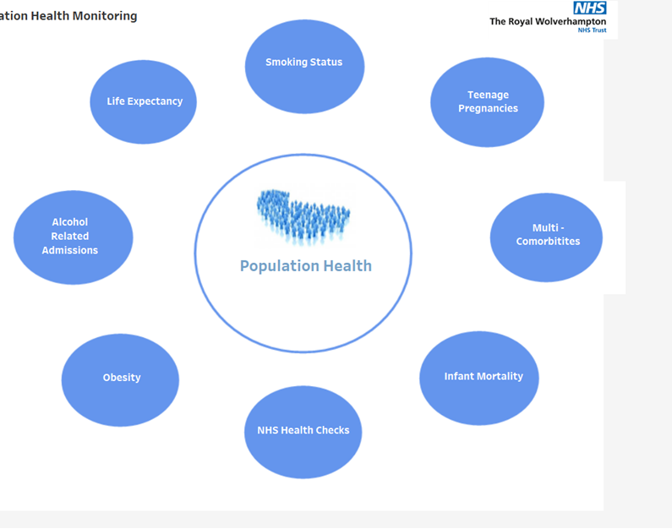
Population Health Module-RWT

Slide 19
Integrated Data System Summary
Live Integrated Dataset linking primary, secondary and community data
Decision support tools such as safety alerts, preventive-care reminders
Performance monitoring and reporting capabilities
Live Practice Level information on
  A&E attendances
  Current Inpatients
  Quality and Safety Checks
  Trend Analysis
  Patient Journey Mapper
  Patients who should be discussed at MDT
  Mortality Information
  Predictive Modelling- Enhanced version PARR-30 (Nuffield)
Transforms Fragmented information currently held in silos into a single view of an individual’s care

Slide 20
ICS Ambitions
To modernise and support primary care to improve care quality and financial sustainability
To redesign our local NHS system by removing barriers that act against integrated care, to support strategic commissioning and move to single back office teams across CCG and Trust
To redistribute risk in a better a way across the system
Improve population health outcomes in partnership with the commissioners mental health services, social care services, public health and the voluntary sector
To improve co-ordination of services and move care out of hospital where appropriate- Integrated patient focussed care delivery
Link together hospital services to improve care quality and financial sustainability

Slide 21
Progress in our City and surrounds
Capability | Progress
Leadership & Governance | Joint executive CCG/Trust group established
Clinical Redesign/ Care Co-ordination | Joint Medical Directors group established
Financial & Risk Management | Risk and Reward Share in development
Reporting and Analytics | Mature
IT infrastructure and Interoperability | Mature
Patient/Citizen Engagement | Established
Public Health/Population Health Management | Established
Wider Stakeholder Relationships | Mature

Slide 22


Questions?
19 February 2018
In Wolverhampton, for example, many GPs have chosen to become directly employed by the hospital, abandoning their old small business status to work in one combined hospital and community system, as Bevan always wanted
Polly Toynbee
The future, is integrated care partnerships that draw together local NHS services into voluntary groupings combining hospitals, GPs, community services and local authorities
Professor Chris Ham

