Slide 1
STPs and the NHS
Dr David Wrigley
West Midlands Regional Council
27th April 2017

Slide 2
About me
GP in Carnforth, Lancashire since 2002
Blackpool born and bred
Qualified Sheffield University 1997
Deputy Chair BMA Council & Lancashire/Cumbria regional rep GPC
BMA lead for STP policy
Co-author of book ‘NHS for Sale’

Slide 3
STPs (sustainability and transformation plans)
England divided into 44 Footprint areas – not statutory bodies but ‘collective discussion forums’ comprising CCGs, service providers and local authorities
5 years plans are main delivery structure for implementing 5YFV and new care models
NHS England’s ambition: new models of care to have 50% population coverage by 2020
Concerns around the STP process: transparency, consultation, focus on savings rather than standard of patient care and governance

Slide 4
ARM policy
That this meeting deplores the projected future reorganisation of the NHS into 44 Sustainability and Transformation areas (Transformation Footprints) linked to Local Authorities which:-
will require each area to have a Five Year Plan in place by September 2016;
will develop new models of health care policy without reliable supporting evidence and;
must achieve financial balance with the threat of large penalties for failure and calls on the BMA to condemn this massive “top-down” reorganisation.

Slide 6
5YFV (five year forward view)
Published October 2014 – led by NHS England
Emphasis on:
Prevention and public health agenda
Moving care out of hospitals
Strengthening and expanding primary and community care
Collaboration and integration
Patient empowerment/self care
Better use of technology
Identified a £30bn funding gap: called for £8bn extra funding and £22bn efficiency savings
Proposes a number of new models of care

Slide 7
The current financial reality
5YFV ‘efficiency target’ of £22bn always likely to be unrealistic
The spending review announced an additional £8bn in NHS funding, purportedly fulfilling the needs of the 5YFV. But widely accepted (including by the Health Committee) that this figure is only £4.5bn, due to accounting changes.
Equates to a real-terms increase of on average 1.1% a year over this parliament, with 0% in 2018/19 and 0.3% in 2019/20
Higher than predicted provider deficits: £2.45bn total provider deficit at the end of 2015/16, with 85% of acute trusts in deficit
General practice underinvestment: as a percentage of NHS funding, spending on general practice has fallen from 10.4% in 2005/6 to 8.1% in 2015/16.
Notes:
The Spending Review re-defined NHS funding as simply NHS England’s budget, whereas previous governments have defined NHS funding as the whole Department of Health budget, including items such as the cost of training doctors or public health spend.
This meant the government could generate around £3bn of its extra £8bn through real terms cuts to other parts of the Department of Health spend. Calculations by the Nuffield Trust, The Health Foundation and The King’s Fund show that when the previous definition of NHS funding is used, total health spending will only rise by £4.5bn in real terms between 2015/16 and 2020/21.

Slide 8
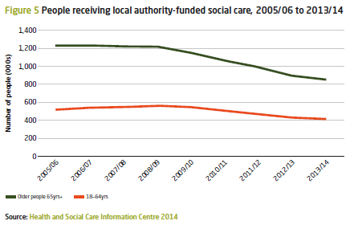
Financial reality continued
5YFV called for improved access to social care and “a radical upgrade in prevention and public health”
But: the spending review cut public health budgets by £600m by 2020/21 in addition to £200m of cuts in 2015/16
Social care funding has been cut significantly over the last six years. This has led to a 26% reduction in the number of people aged over 65 receiving publicly funded social care.
It is estimated that there will be social care funding gap of £1.9bn next year
Highlighted in Health Committee’s letter to the Chancellor ahead of the Autumn Statement

Slide 9
Current context: secondary care landscape
Workforce
Shortage of doctors training to be medical specialists.
Seven out of ten doctors-in-training report working on a rota with a permanent gap
Hospitals failing to fill two out of every five consultant physician posts they advertise.
Workload
Four of five doctors-in-training report that their job causes them excessive stress
Doctors-in-training work an extra 5 weeks per year on top of their rostered hours.
Funding crisis
Will come back to: provider deficits and real-terms increase only 1.1% a year on average
Impact on patients
Total elective waiting list: now at 3.7 million – the longest since 2007
A&E waits>4 hours: worst performance since 2003
95% of doctors in training report poor staff morale has a negative impact on patient safety

Slide 10
Current context: general practice landscape
Workload
Demand>> capacity – unabated workload pressures
68% of GPs perceived their current level of workload as unmanageable or unsustainable
Regulatory burden (CQC) adds to this
Workforce
Number of GPs per head of the population has been declining – thousands short.
GP vacancies widespread. Increasing work for remaining GP partners.
Funding
Will come back to: reducing resources and unfunded workload shift
General practice imploding
1 in 10 practices feel financially unsustainable in next 5yrs
200% increase in practice closures and mergers

Slide 11
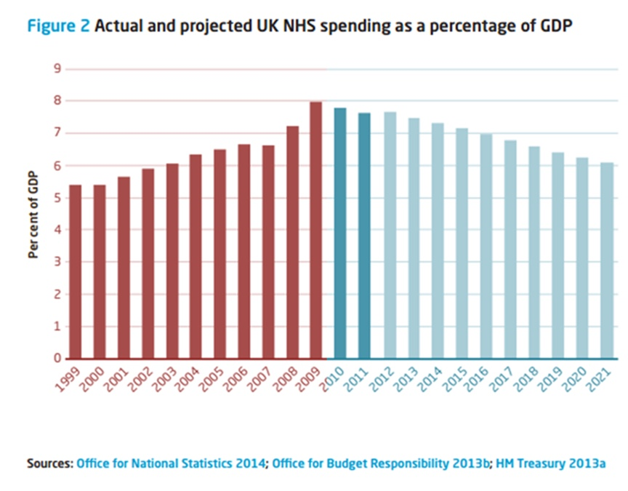

Slide 12
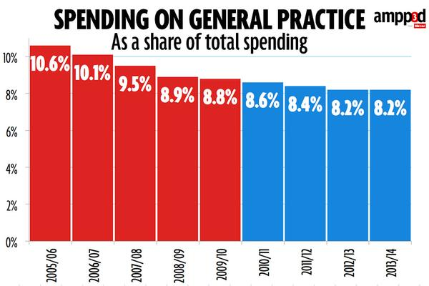

Slide 13
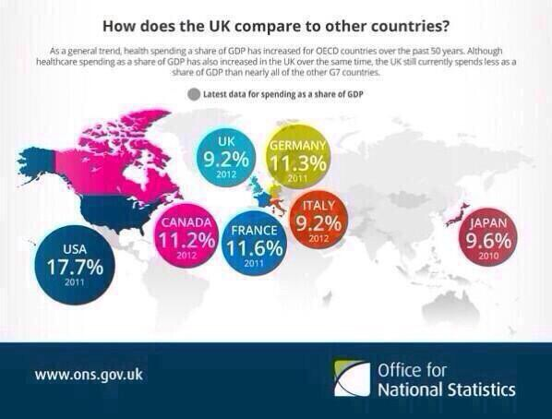

Slide 14
New models of care
New models of care to deliver integrated, population-based care, which benefit from at-scale working
Capitated population based budgets, new payment systems
Radical organisational and contractual changes
Five new care models are being piloted by 50 vanguards
Multispecialty community providers MCPs
Primary and acute care systems PACS
Urgent and emergency care:
Acute care collaborations
Enhanced health in care homes

Slide 15
Source: NHS England; published 24/11/16

Slide 16
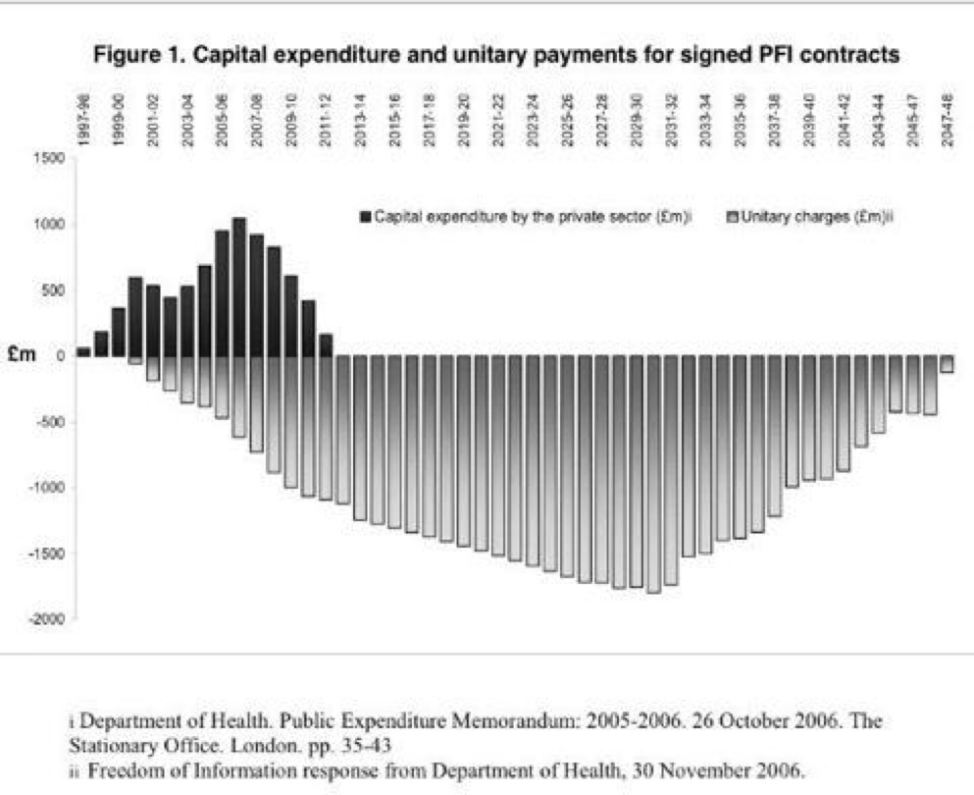

Slide 17
Why we are in a mess
Expenditure per head of population
$8713 in USA
$5131 in the Netherlands
$4819 in Germany
$4124 in France
$3235 in the UK
Hospital beds per 1,000 people
8.3 in Germany
6.3 in France
3.1 in Denmark
3.0 in Spain
2.8 in UK
Doctors per 1,000 people
4.1 in Germany
3.9 in Italy
3.4 in Australia
3.3 in France
2.8 in the UK

Slide 18
Norfolk & Norwich University Hospital
Contract signed 1996
Go ahead by Mr Blair 1998
Total cost to build £229mn
NNUH pay Octagon PFI consortium £57mn per year until 2037
Total cost to tax payer is £1.16bn
Current deficit £32mn/yr

Slide 19
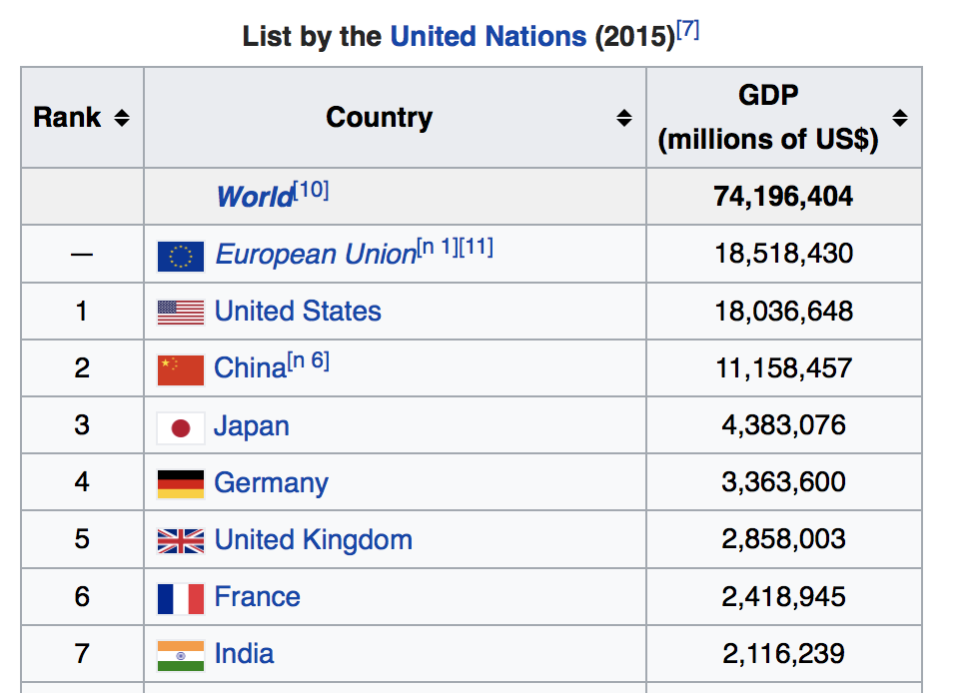

Slide 20
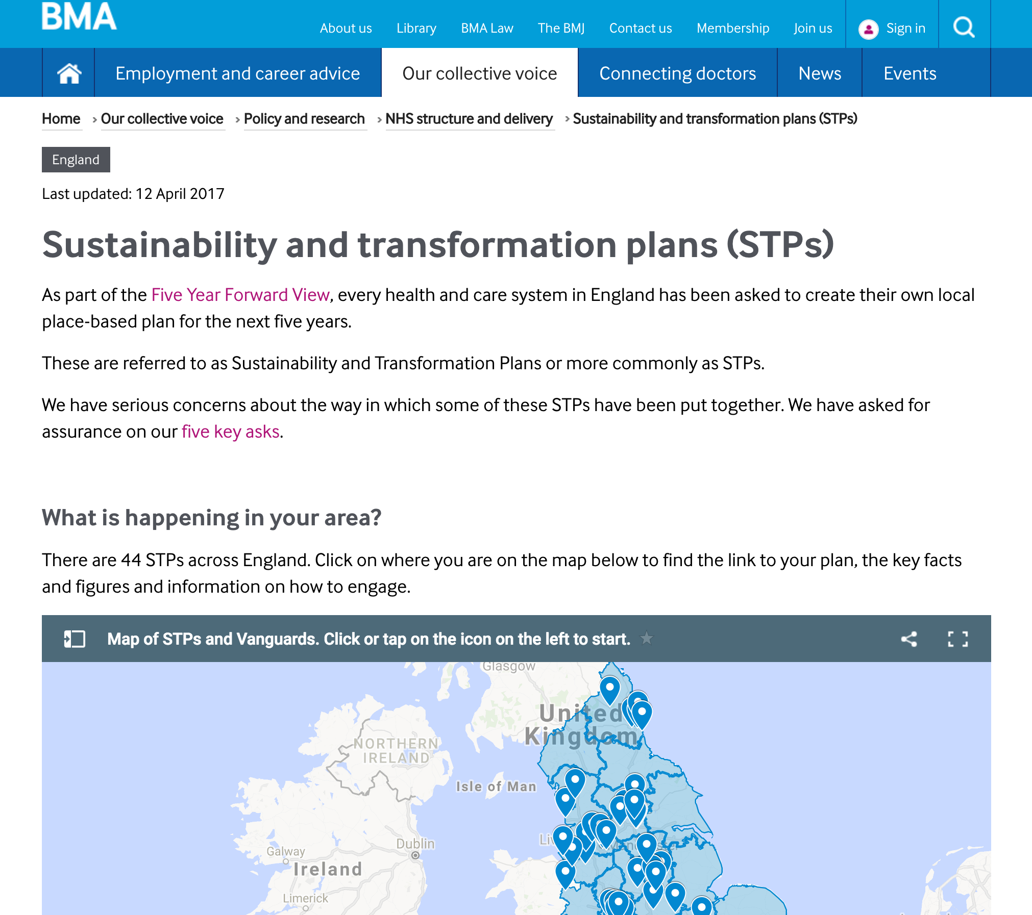

Slide 21
Five asks
The plans need to be published as soon as possible.
All proposals within the plans need to be realistic and evidence based.
Commitment to full consultation with clinicians, patients and the public.
The plans need to be funded properly.
Patient care, not savings, need to be the priority of each and every plan.

Slide 23
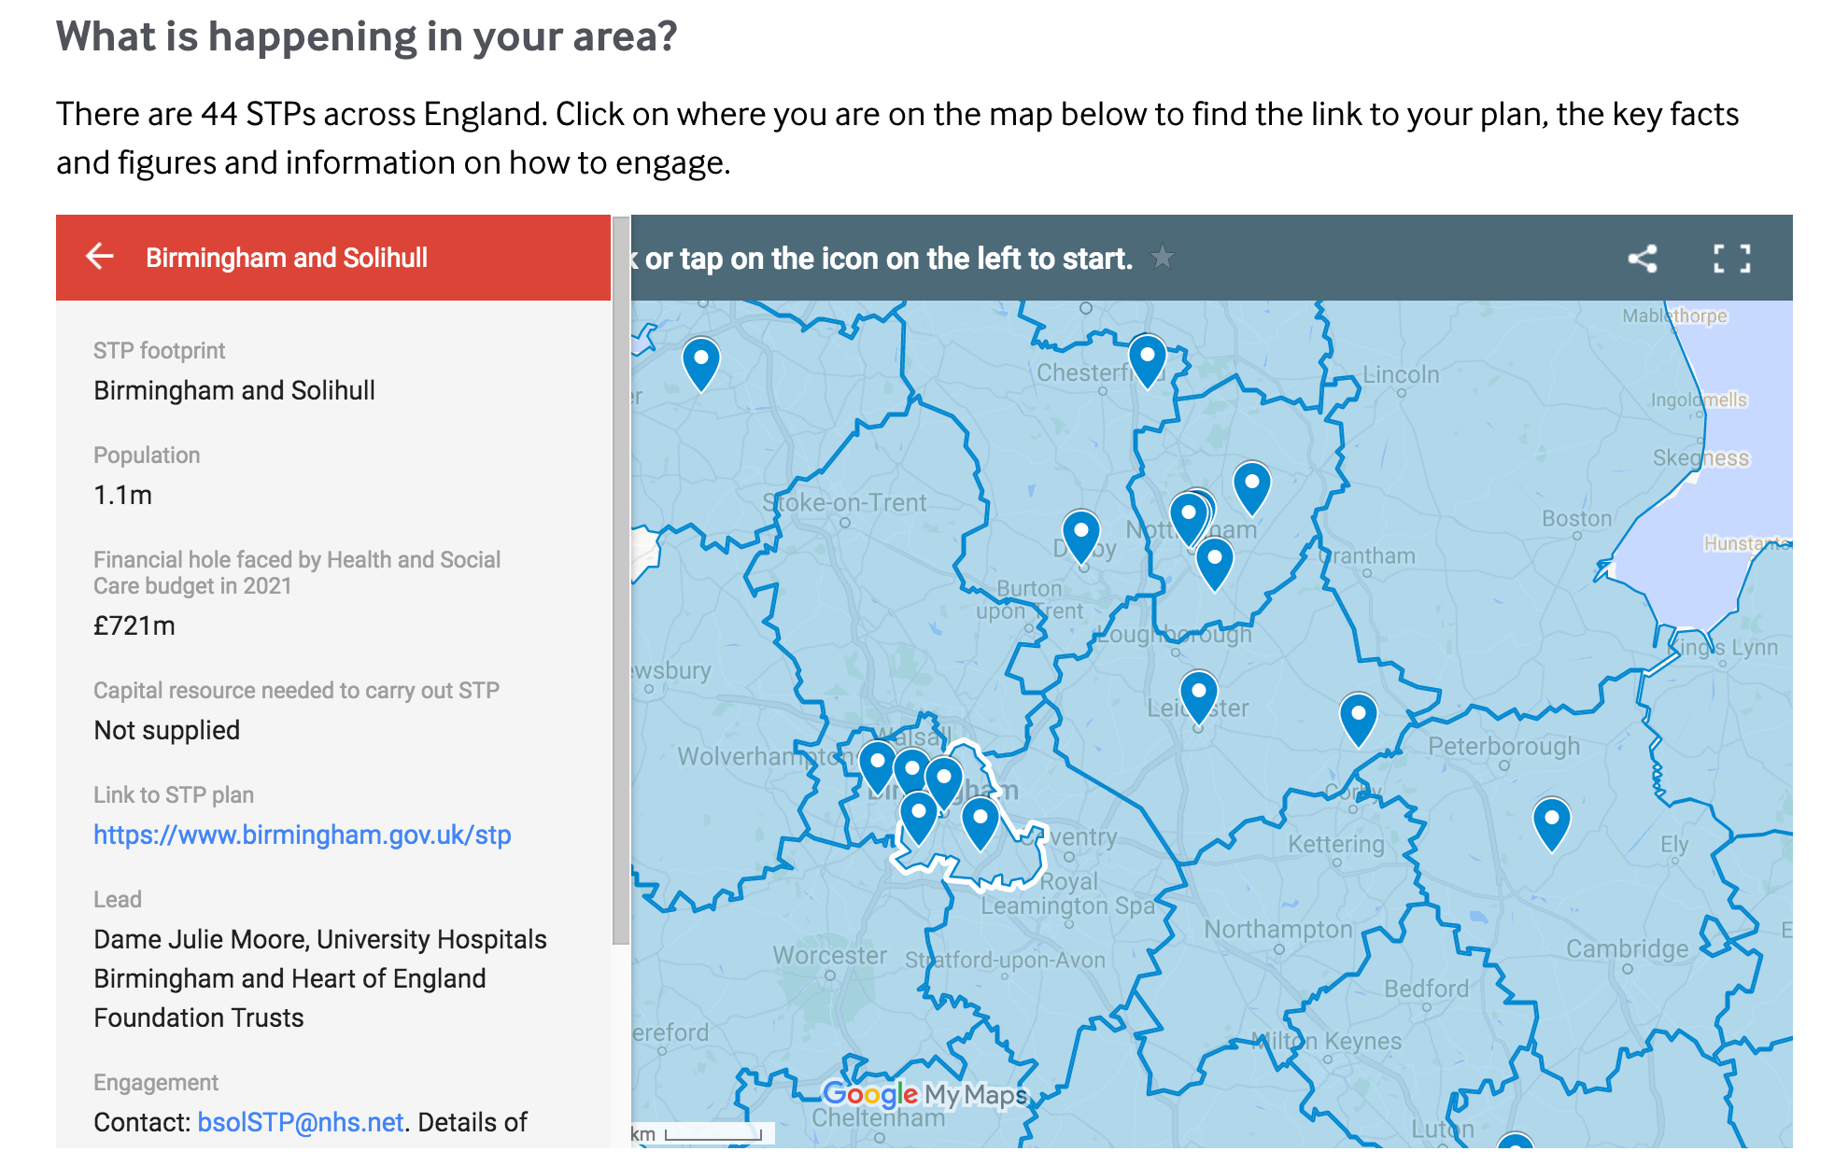

Slide 24
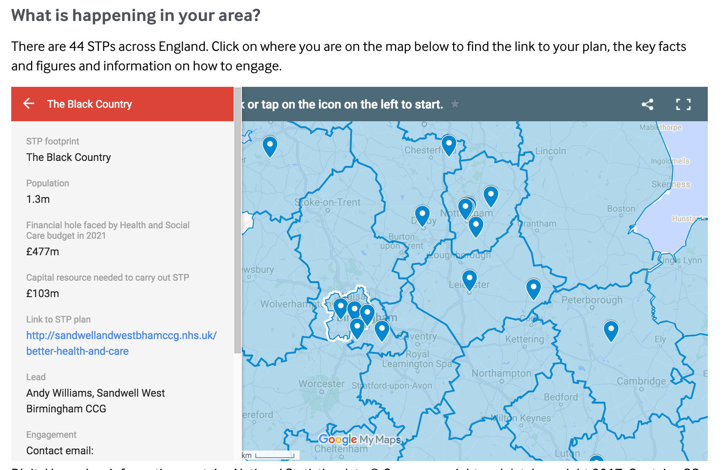

Slide 25
STPs covered by WMRC and ‘efficiency savings’ required
Staffordshire & Stoke-on-Trent £542mn
Shropshire & Telford & Wrekin £131mn
The Black Country £700mn
Birmingham & Solihull £712mn
Coventry & Warwickshire £300mn
Herefordshire & Worcestershire £337mn --------------
£2.722bn
Capital costs required too - £531mn

Slide 26
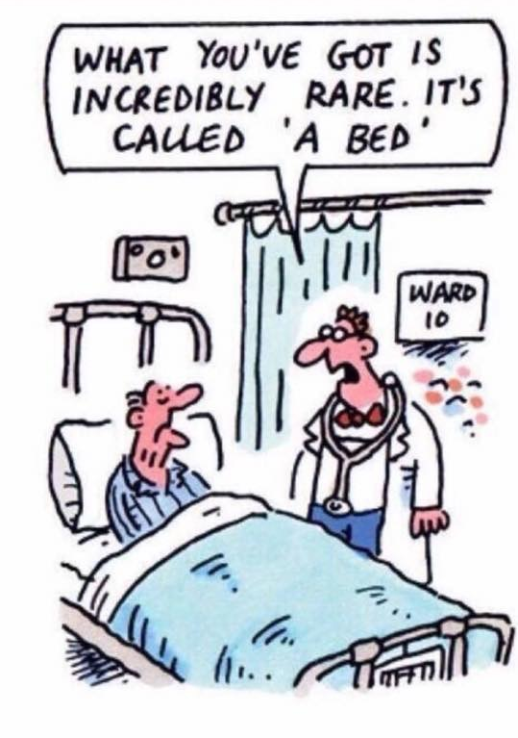
Any Questions?
ANY QUESTIONS?
Email dgwrigley@doctors.org.uk
@davidgwrigley

