Slide 1
General practice 2017/18
Chaand Nagpaul, chair GPC

Slide 2
Overview
Response to challenges facing general practice
2017/18 contract negotiations
Current issues
General Practice Forward View
Primary/secondary care interface
Multi-specialty Community Providers (MCPs)
Working together at scale
GPC/LMC partnership

Slide 3
Response to challenges
Financial context: Crisis across whole of NHS and social care, impacting on GPs
  5YFV: £8b investment (reality £4.5b?); £22m funding cuts
  Crisis across general practice, community, hospitals, social care
  All authoritative opinion- operating on inadequate NHS funding: Health select committee letter to PM; NHS E Chief exec Simon Stevens
  No imminent government plan for increased funding: Brexit, Autumn statement no mention NHS
2017/18 national contract negotiations
Ensure commitments and funding in GPFV delivered and not be limited by it; UPGP
BMA GP survey – solutions for general practice must be cognisant of diversity of profession and aspirations, environment outside the core contract

Slide 4
Contract overview
Annual revision to contract; limited to scope of contract
Call for stability (LMC conference)
Will not sort out the overall problems for general practice
Local commissioned services can have greater financial impact on practices
Unresourced workload outside contract remains important area to address
GPC will not accept any contractual change to extending GP opening hours

Slide 5
The GP contract as part of a wider environment
CCG
Sessional/chambers/portfolio GPs
Hospitals
Social Care
Local commissioned services
Secondary to primary workload shift
GP practice core contract
Community nursing provider
Networks/Federations MCP New models
Patient demand
Mental Health Services
Community pharmacy

Slide 6
Avoiding Unplanned Admissions DES
  Discontinued with £156.7m added to global sum
  Replaced with focus on identifying the severely frail using appropriate tool (e.g. eFI)
  Will apply to approx. 3% of over 65s (0.5% of practice population - current AUA DES is 2%)
  Annual review to include medication review and post-fall review, where clinically appropriate – no care plans
  Promoting consent for enriched SCR
  Data extraction on med reviews/falls/SCR consent, and numbers with moderate frailty
  Not to be used for performance management or benchmarking

Slide 7
Expenses
  CQC fees full re-imbursement
        System of direct reimbursement – unweighted
        Practice will pay and then send invoice to NHS England for reimbursement
        Embeds system to have future increases funded
        £15m will be taken off agreement this year to account for funding put into global sum last year
Funding to cover annual rise in indemnity costs
        £30m scheme to cover average increase
        Separate SFE based payment – unweighted

Slide 8
Other new funding
  Expenses funded to deliver 1% pay uplift
  Primary Care Support England services (Capita) - £2m for increased practice workload as a result of changes
  Workforce census – £1.5 m to cover completion - contractual requirement
  Superannuation increases – £3.8m to cover 0.08% pension admin charges
  Overseas visitors changes - £5m to cover admin workload involved
  Business improvement district levies reimbursement - £1m
  Learning Disabilities ES - increase from £116 to £140 per health check
  £238.6 million additional investment into the contract for 2017/18
  Global Sum increase of 5.9% - £80.59 to £85.35 per head

Slide 9
Sickness and maternity reimbursement
Sickness cover reimbursement
      Discretionary status removed
      List size criteria removed
      Cover to start after two weeks sickness
      Existing GPs in practice can be used to cover - mirroring maternity arrangements
      Amount payable uplift in line with maternity – up to £1734.18 per week
      Will reduce practice out of pocket locum expenses and locum insurance costs
      Should improve terms for salaried GP sickness absence
  Maternity payments
      Not be subject to pro-rata system
      Practices will submit invoice - full amount or maximum payable under the SFE will be paid

Slide 10
Overseas visitors
Covers patients with a non-UK issued EHIC or S1 form
Country of origin will be charged, not patient
Practices will be provided with patient information leaflet (hard copies)
Amendment to GMS1 form – patients from overseas will self declare
Practice will scan and email/post form to NHS Digital
£5m will be added to contract on recurrent basis

Slide 11
Data collection
INLIQ and retired enhanced services
    Will be mandatory extraction of agreed indicators
  National diabetes audit
    Will be mandatory
    Joint letter will be sent to system suppliers to put pressure on enabling fully automated system

Slide 12
Opening hours
National Audit Office report and recommendations: 700+ practices regularly close for one ½ day per week;
GPC committed to working with NHS England to ensure locally responsive, safe and appropriate access during core hours (focus on weekly half day closing)
Local Medical Committees will be integral partners in local discussion
Changes to the qualifying criteria for the Extended Hours DES; excludes practices with weekly half day(s) closing as of October 2017

Slide 13
QOF
Increase to QOF point value in line with CPI adjustment
No changes to indicators for this year
Commitment to work on replacement system for 2018/19
Ongoing discussions on any replacement or distribution of funding
Difficult issues due to change in funding distribution if moved to global sum and risk of potential new work required using QOF funding

Slide 14
Other areas of agreement
Registration of prisoners immediately prior to their release
Vaccination and immunisation
      Minor amendments to existing programmes
      £6.2 million to include morbidly obese in eligible cohort for influenza vaccinations
      No new programmes
  New GP retainer scheme
  Dispensing negotiations to be conducted by separate group
  Expenses methodology survey to be undertaken

Slide 15
IT– all non contractual
practice compliance with National Data Guardian Security Review
practice completion of the NHS Digital Information Governance toolkit
an increased uptake of electronic repeat prescriptions to 25% (with reference to pharmacy)
an increased uptake of electronic referrals to 90% where this is enabled by secondary care
continued uptake of electronic repeat dispensing with reference to CCG use of medicines management and co-ordination with community pharmacy
uptake of patient use of one or more online service to 20% including, where possible, apps to access those services and increased access to clinical correspondence online
better sharing of data and patient records at local level, between practices and between primary and secondary care

Slide 16
Current issues – SBS, TPP QRISK and Capita
SBS note transfer failure – negotiated compensation
      LMCs have been notified
      Practices should now have received copies of correspondence and details of how to claim for workload
TPP and QRISK
      Issue of compensation being addressed and hope to announce soon
PCSE/Capita – compensation being addressed; workload of labelling and bagging records in contract 2017/18

Slide 17
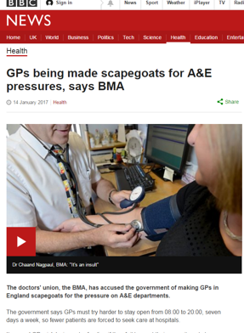
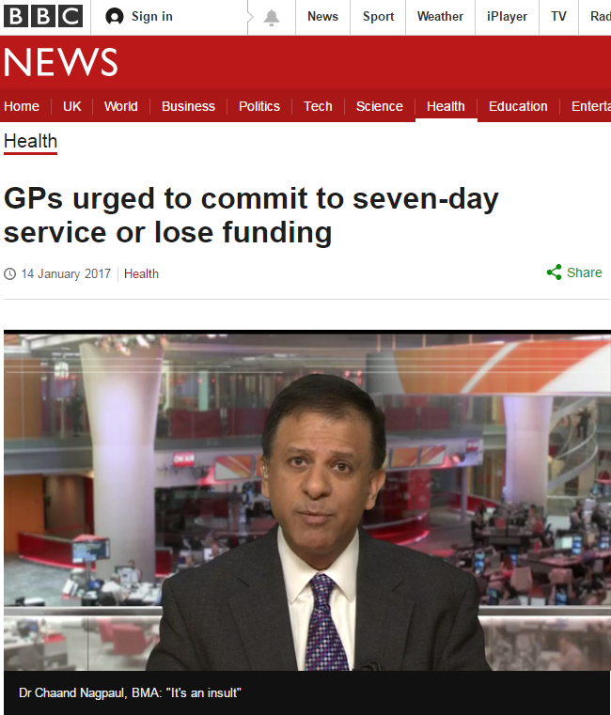
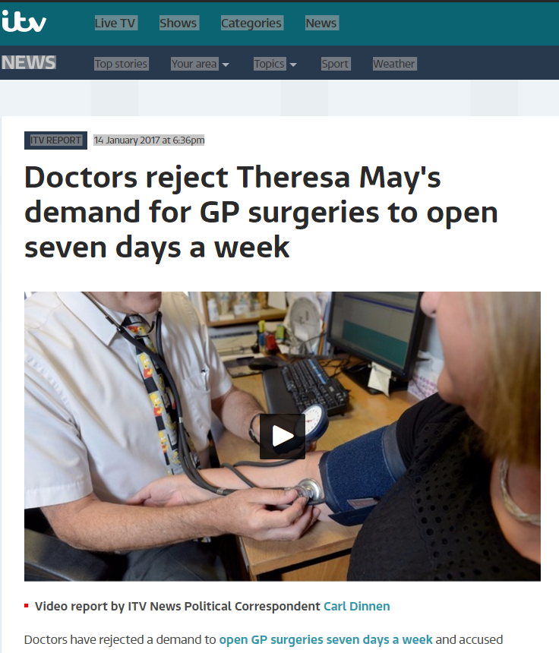
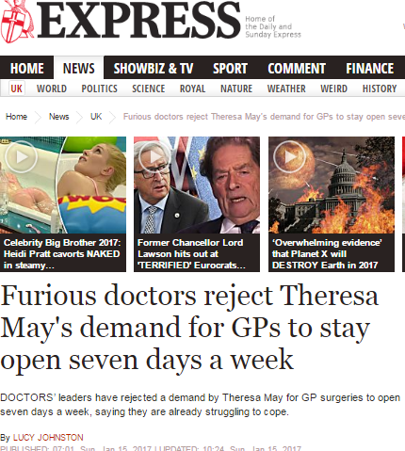
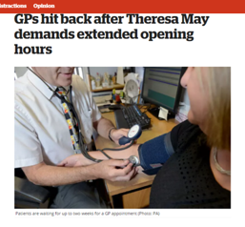
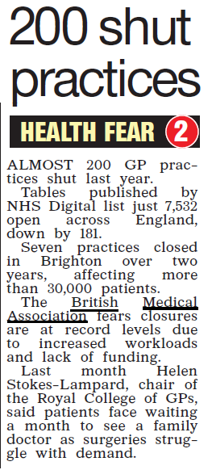
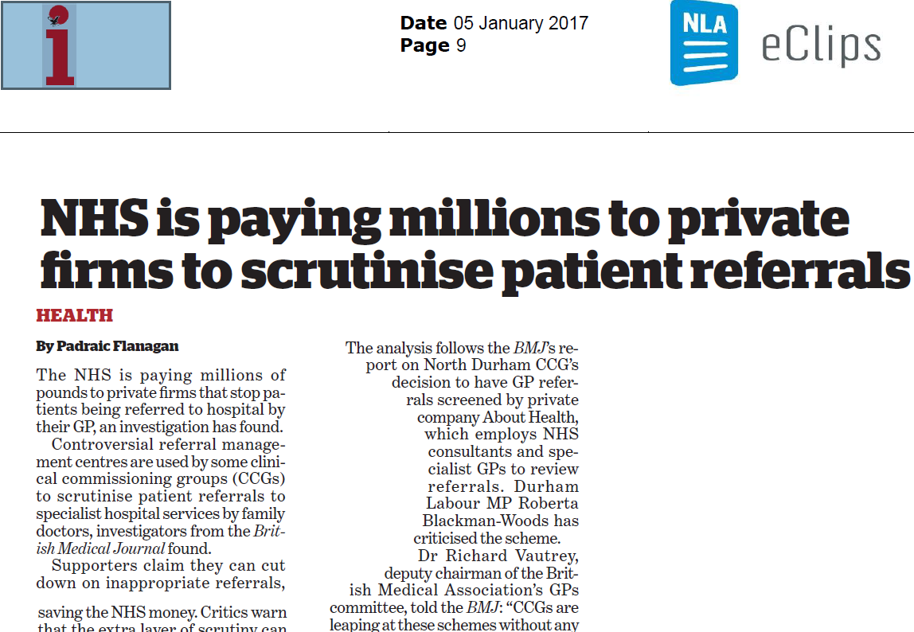
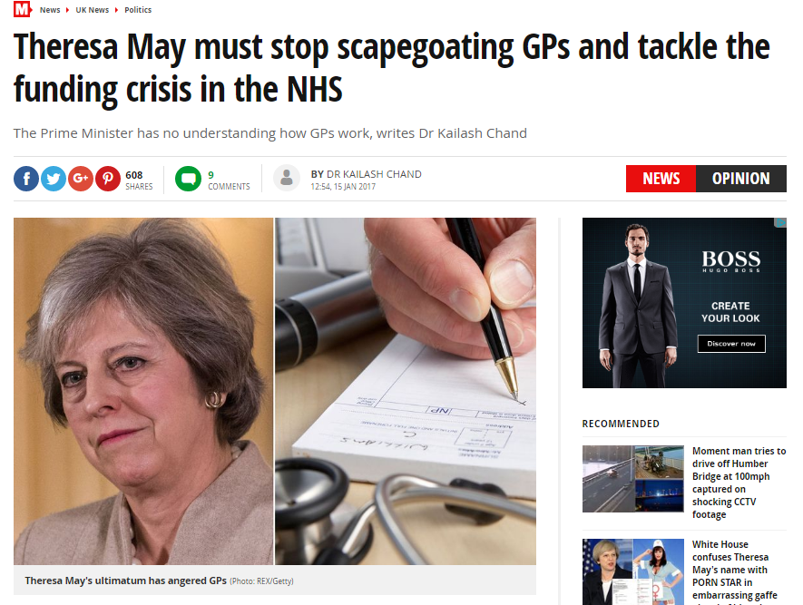
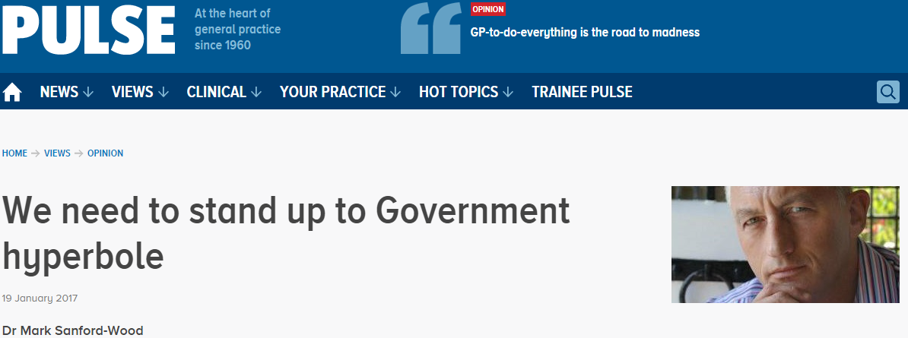
Recent news coverage – fighting your corner

Slide 18

GP Forward View
Announced 21st April 2016
5 year support programme
£2.4 billion extra recurrent
funding by 2020/21 (14 vs 8%)
£506 million over 5 years for Sustainability & transformation non-recurrent
>10% NHS budget by 2020/21; CCG investment on top
Result of GPC UP lobbying
Change in tone by NHSE
What NI GPC are campaigning for
Notes:
Comprehensive package of support to General Practice
Funding will rise to at least 10.4% of NHS spending (close to our call of 11%)
Majority of our asks in Responsive, Safe and Sustainable included – and commitment to discuss outstanding proposals
BUT: proof will be in the pudding

Slide 19
GPFV headline areas and progress (1)
Practice resilience programme (£40m) -2016/7: £16m – needs to be given to practices by 30 March
Indemnity fees increase reimbursement – 2017/18 contract negotiations, OOH – 2016/17 winter indemnity scheme; longer term solution via GP Indemnity Review Group
CQC expense rise recompense – contract negotiations
Support for burnout and stress (£16m)- just gone live
GP Development Fund to manage workload/shape demand (£96m) –started this year
Transformation monies 17/18 onwards for working at scale (£171m) – to go live April 2017 onwards
Review mandatory training – working with RCGP
Commitment national self-care programme – discussions with NHSE

Slide 20
GPFV headline areas and progress (2)
GP access monies:
£500m recurrent by 2020/21
Phased investment- all areas to receive £6 per head by 2019
No requirement for 8-8 7 days; local determination for weekend access hours
Can be used to support in-hours GP capacity
Can be for urgent appointments, and integrated with urgent care/GP OOH
Can be delivered via locality hubs
Need to use to support current GP pressures; overflow work

Slide 21
GPFV: Primary-secondary care interface
Hospital standard contract changes to reduce inappropriate secondary care shift – went live 1 April 2016
Issue | 2016/17
Referrals | Hospitals to stop asking GPs to re-refer DNA appointments Hospital to make internal referrals for related problem and not ask GP to re-refer
Communication with the patient and fit notes | Hospital to follow up investigations and inform patient
Discharge summaries | Discharge summaries within 24 hours
Clinic letters | Clinic letters within 14 days
Drugs | Adequate supply drugs on discharge

Slide 22
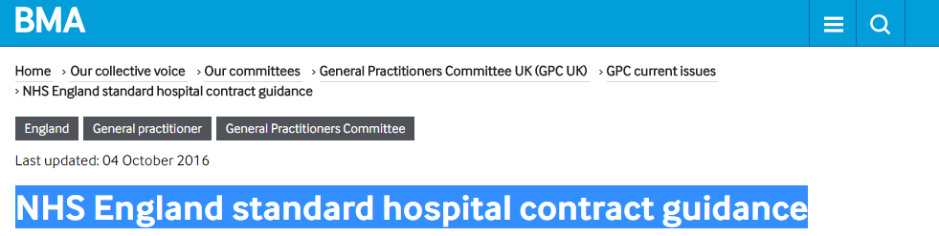
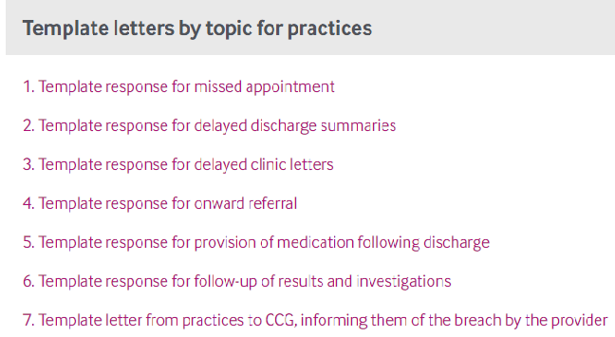
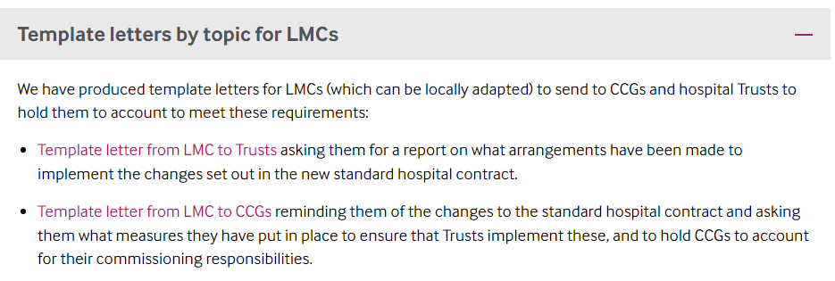

Slide 23
GPFV Primary-secondary care interface (2)
Dedicated GPFV primary-secondary care interface group to address interface problems and workload shift – Urgent Prescription priorities
Issue | 2017/18
Communication with the patient and fit notes | Hospital to put in place arrangements for handling patient queries (from patients and GPs) Hospital to issue fit notes to patients where needed
Discharge summaries | Discharge summaries from A&E within 24 hrs and direct electronic transmission from Oct 2018
Clinic letters | Clinic letters within 10 days (April 2017) and 7 days (April 2018) and move to electronic transmission using structured clinical headings (Oct 2018)
Prescribing | Dedicated prescribing interface group. Outpatient and specialist prescriptions, share care arrangements, use of hospital FP10s and developing hospital EPS, hospital monitoring of specialist medications

Slide 24
GPFV General Practice Development Programme
Releasing Time for Care – 10 high impact areas (£30m) 67 groups (2,000 practices signed up)
Training for reception and administrative staff (signposting, handling incoming clinical correspondence) (£45m)
Practice manager development (£6m)
Online consultation systems (£45m) – e.g. Askmy GP, WebGP or smartphone apps – available April 2017 onwards
Need LMC/practice and CCG awareness – small amounts of money will stretch much further with groups of practices

Slide 25
GPFV progress: workforce
GP recruitment and retention:
Induction and Refresher Scheme
GP Targeted training programme
Improved retainer scheme
International doctors recruitment
GP mental health service (to prevent burnout)
20k bursary in under-doctored areas
GP career plus pilot scheme
Practice based pharmacists (£112m ;1 pharmacist/30,000 pts) –just announced
1000 PAs, 3000 practice based mental health workers (1 per 2- 3 practices)
Extended scope practitioners; enhanced nurses, paramedics, physios
Training funds for practice managers (£6m) , nurse development (£15m), reception staff training & clinical admin support (£45m)
Medical assistant pilots

Slide 26
GPFV: GP Health Service
Launched end January 2017 – based on model operating in London
Free, confidential service for GPs suffering with mental health or addiction issues
Self referral only
Contact details:
Opening hours: 8.00 – 20.00 weekdays and 8.00 – 14.00 Saturdays
Website: www.england.nhs.uk/gphealthservice
Tel: 0300 0303 300 Email: gp.health@nhs.net

Slide 27
LMCs vital to ensure local implementation delivery
GPC: GPFV implementation policy group; central pressure and oversight; NHSE GPFV advisory group
GPFV delivered locally; CCG plans 23.12.2016
LMC role – monitor, influence, ensure commitments and spend delivered
LMC reference group for GPFV set up – direct engagement with NHS England; real time- feedback
Guidance to LMCs with LMC checklist for CCGs GPFV plans (December 2016) and monitoring template (January 2017)

Slide 28
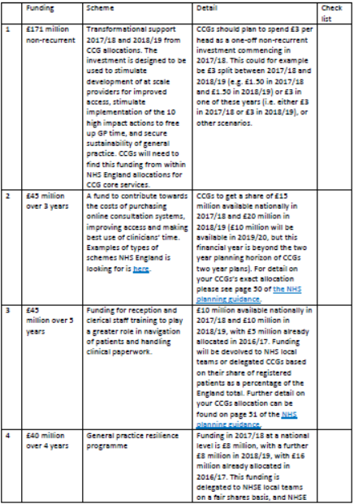
GPFV LMC engagement (1)

Slide 29
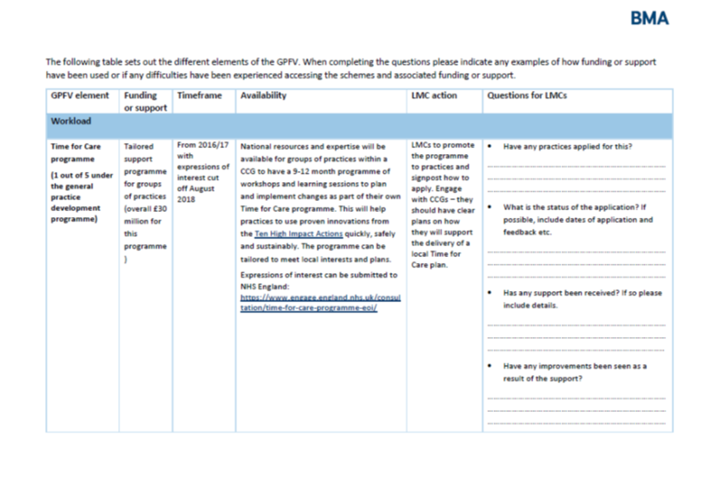
GPFV LMC engagement (2)

Slide 30
GPFV: premises
Awaiting updated Premises Cost Directions
    Includes 100% funding for premises grants in certain circumstances
NHSPS lease agreed
    Support for practices signing the lease within two years of release:
        Stamp Duty Land tax covered
        Legal fees paid (up to £1000+VAT)
  Service charges transitional support – discussions ongoing
    Any NHS PS or CHP premises will receive transitional support if their service charges have risen recently
        Two years of NHS England automatic support (i.e. no need to claim, will automatically be done between NHS England and NHSPS/CHP, and identifiable on the invoice)

Slide 31

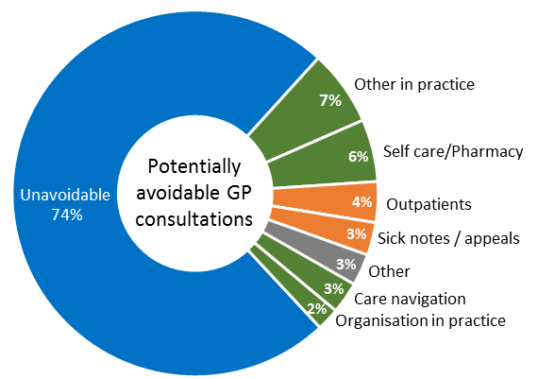
Managing Workload and demand: potentially avoidable
GP consultations
Self-rating by GPs
1 in 4 GP appointments potentially avoidable
“Making Time in General Practice” report – NHS Alliance/Primary Care Foundation

Slide 32
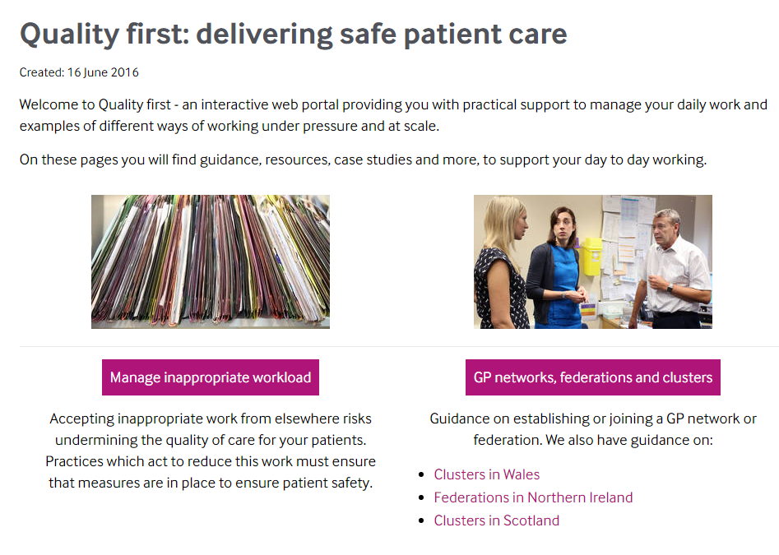
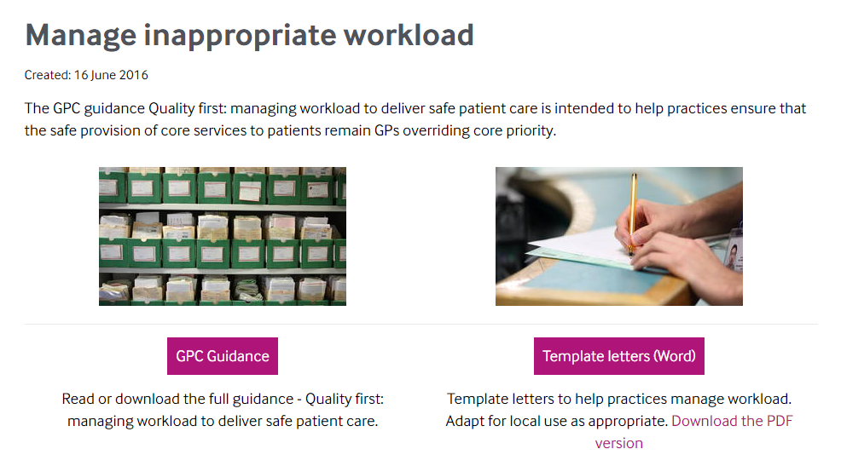
Quality First website (www.bma.org.uk/qualityfirst)

Slide 33
BMA GP survey – some key findings (1)
GP partners under greatest pressure
6% partners feel work manageable c.f. 12% salaried GPs, 34% locums
Only 1 in 5 partners content with current job; 1 in 3 looking for alternative work
Just under half GPs (47%) want to work as partners in the next 5 years
79% GPs believe there should be incentives to work as partners
GPs want varying career options, willing to consider other models – 32% willing to work in new care models, 19% employed in MCPs
Measures to reduce workload: self-care/management and increased community nurses and skill-mix most popular
New funding in general practice – highest responses for increased community nurse and skill-mix support (46%), 28% wanted all investment in global sum

Slide 34
BMA survey: action to reduce workload
Q2. | Which of the following would you consider doing in order to safely manage practice workload?
Withdrawal of wider non-contractual services that GPs voluntarily provide | 60.7 %
Restricting clinical work to contractual essential services, and increased use of external referral for non-core services | 40.9 %
Withdrawal from local CCG meetings and activities | 35.2 %
Temporary suspension of new patient registrations | 34.1 %
Withdrawal from enhanced services, such as the provision for minor surgery, extended hours | 34.0 %
Working at scale | 33.6 %
Application to reduce practice boundary and remove patients from the list | 26.0 %
Withdrawal from the quality and outcomes framework | 23.4 %
Withdrawal from additional services, such as the provision of contraceptive services | 14.2 %
I don’t need to take any further measures to manage workload | 6.2 %
Other | 23.8 %
The list of items provided is the list from the briefing on industrial action of possible actions that could be taken

Slide 35
Working together to sustain general practice
Individual GP practices vulnerable
Working collaboratively to support each other
BMA GP survey: One model no longer fits all
49.6% believe ICM should be supported to work in networks/collaboration (c.f 47.2% supporting ICM as prime model)
32% support multi-professional collaborative model including MCPs
Prime reasons for collaborative working : reduce bureaucracy, workload, extended access; security and sustainability of practices within a larger organisation

Slide 36
MCPs (multispecialty community providers)
Scale 30,000+ population, groups of practices
6 pilot sites 2017/18
MCP contract advisory group
3 contractual options-practices can retain G/PMS
10-15 year contract with MCPs; unified capitated population budget
Practices can have alternative subcontracts in MCPs, “right to return” (logistics?)
GPs can be employed by MCP
VOLUNTARY – practices can be part of MCPs by retaining current national contract
Alternative voluntary contracts being developed
Virtual MCP
Alliance agreement
Partially integrated MCP
G/PMS for core general practice
Fully integrated MCP
Single MCP contract for all primary care and community services
MCP contract for all other services
No change to current contractual arrangements

Slide 37

Contracts and services within an MCP
CCG/Commissioner
Core contract
GP practice
GP practice
GP practice
GP practice
Non-core services
MCP
Sub-contract with MCP
Alternative MCP contract
MCP
GP practice
GP practice
GP practice
Community services
Out of hospital specialist clinics and diagnostics
Secondary care services contract
Hospital services
Highly specialised services
8

Slide 38
Move away from national contracting
  Undermines a consistent standard of national and equitable care to patients
  Local GP contracts: Loss of national protections and T&Cs; increased bureaucracy in local negotiations
    QOF achievement will still be monitored and performance managed (NHS E primary care web tool, CQC)
    New performance pay to replace QOF? Net increase workload?
  A significant move towards a locally determined contract would undermine the collective bargaining rights for remaining GMS practices.
  Locally determined employment models would undermine national model contract for salaried GPs.
  Time – limited contracts and procurement

Slide 39
What practices should do now
  The MCP contract will initially affect practices in one of 6 MCP pilot sites
  Being considered in many STP plans
  Remember any MCP involvement is voluntary – do not feel coerced
  GPC guidance; can seek LMC or BMA advice
  Consider carefully: organisational;/legal/financial implications – need specialist professional advice
  GP practices can work at scale other than in MCP arrangements with aim to support practice workload and sustainability
  LMCs should support practices to develop bottom-up GP owned models – offer lifeline to practices as alternative to MCPs

Slide 40
GPs working at scale – emerging realities
Practices working collaboratively as network provider/federation
Devo-Manc and others
Development of MCPs
Primary care home
Super-practices - c.50 in England with 30,000+ patients
Acute Trusts running or contracting with GP practices
PACS/ACO development
Emphasised in the GPFV
Funding is available via the transformation fund (£171m) and the access fund (£500m)

Slide 41
Working at scale – supporting practices, managing workload, developing the workforce
Network provider/hub
Community provider
Supporting practices
Managing workload
Developing the workforce
Management Back office Proactive/ crisis support
‘Overspill’ urgent cases telephone triage remote admin
Employer of staff Sessional GPs Skill mix e.g. pharmacists Education and training
Integrated nursing teams
Shared staff
Shared services
Cross cover
GP practice
GP practice
GP practice
GP practice

Slide 42
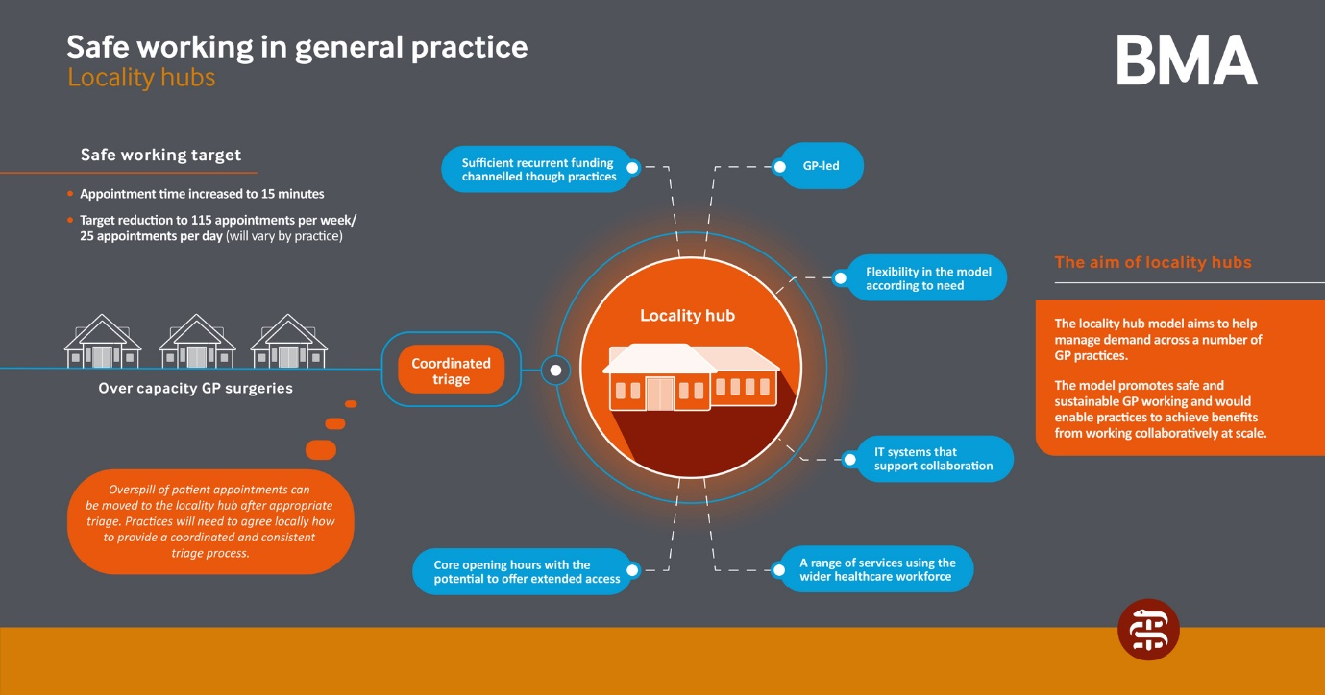

Slide 43
Case Study (Federation): Essex
How it works | How it’s helped
9 practices (50,000 patients) Working together through a Memorandum of agreement between the practices Agreed Care/Nursing home visits Sharing minor illness clinics Allocated slots depending on list size Jointly commissioned training Agreed pathways Risk share agreed | Reduced bureaucracy Practices more sustainable Manageable practice workload Economies of scale
Example from Essex: 9 practices (50,000 patients)
Working together through a Memorandum of agreement between the practices
Managing workload by:
    Agreed Care/Nursing home visits
    Sharing minor illness clinics
    Allocated slots depending on list size

Slide 44
Case Study (Hub): Richmond, South West London
How it works | How it’s helped
Local GPs (28 practices) operate 4 Hubs, each based in an existing general practice surgery Each Hub can access any patient’s notes (with their permission). Read and write interoperability between GP systems so instant updates and fully-coded entries. Practices triage calls, decide who can and should be seen at the Hub, and book the appointments. Hub GPs see 14 patients over 4 hours at 15 minute intervals. Practices meet regularly as localities to discuss the functioning of the Hubs, equity of access to appointments, and to develop the service. Extending access to support a local Pharmacy First project (to encourage patients to use pharmacy for minor health care issues), and discussing integration with out of hours services. | Hubs add another 5-8% appointments in to the system – taking some strain off local general practice Stops extra appointment availability from driving further demand. Extra resilience Hubs have helped to smooth over periods of staff sickness or leave Positive impact on A&E and urgent care numbers

Slide 45
Case Study (Super-partnership): Birmingham
How it works | How it’s helped
33 practices Population covered 290,0000 and growing with a number of practices going through "due diligence.' Profit Centre model, common in industry, rare in medicine. Single partnership, with original contracts held centrally in trust. Small central corporate team paid for by levy of £2 per patient (tax deductible) Elected board of 7 GPs from across the partnership. Considerable local autonomy (both managerially and financially) with added advantages of being part of a very large partnership. | Single CQC registration, with light touch inspection as per GPFV. Practice quality and support team to reduce duplication and bureaucracy in practice. Sustainable workforce model, starting with internal bank and Salaried Doctor pool to reduce locum costs and increase quality. Reduction in medical indemnity costs and investment in training. Central accounting and banking with monthly management accounts and quarterly benchmarking. Access to buyers scheme discounts. Increased resilience with peer support from other practices. Opportunity for further closer merger and sharing of back office functions Greater local and also national influence

Slide 46
GPC/LMC partnership
Increased and more timely guidance and support
Input from lead LMCs e.g. Humberside LMC paper on GPFV funding stream; NHS property lease
LMC reference group interface with NHS England
More regular executive updates; planning webinars
LMC events: “Working together to sustain general practice” conference 23 February 2017
GPFV implementation and workload management conference planned April 2017

Slide 47
Supporting LMCs Guidance produced for LMCs since January 2016
Focus on funding support from the GPFV
Co-commissioning guidance
GMS Contract and PMS comparison document for LMCs
Physiotherapy guidance and cost calculator
Focus on the publication of earnings
Guidance on urgent prescription
Service charges
NHSPS lease guidance
Gender incongruence
Focus on the NHS England General Practice Forward View
GP locum chambers guidance
Template lease for GP premises, and associated guidance
Patient registration
Safeguarding reports and collaborative arrangements
Focus on PMS reviews
Focus on MCP Contract Framework
Focus on industrial action and undated resignations
Finances of the contract agreement
Focus on GP funding changes
NON-GUIDANCE: GPCE monitoring of Capita performance

Slide 48
In summary…
Operating within grossly underfunded NHS
Successful GP contract negotiation 2017/18
General practice as part of a wider environment
GPFV committed resources must be spent and delivered to support general practice
GPC/LMC partnership vital
Empowering profession to manage workload
Working together; to support sustainability of practices, and models to meet diverse aspirations and needs of GPs
Political pressure/lobbying – general practice needs larger proportion of a larger NHS pot –political choice

