Slide 1
West Midlands LMC
‘Nuts and Bolts’
DR. John Byrne MRCPG
March 6th
1
Notes:
1

Slide 2
Our purpose
The Care Quality Commission is the independent regulator of health and adult social care in England.
We make sure health and social care services provide people with safe, effective, compassionate, high-quality care and we encourage care services to improve.

Slide 3
Our current model of regulation
Register
Monitor, inspect and rate
Enforce
Independent voice
We register those who apply to CQC to provide health and adult social care services
We monitor
services, carry out expert
inspections, and judge each service, usually to give an overall rating, and conduct thematic reviews
Where we find poor care, we ask providers to improve and can enforce this if necessary
We provide an independent voice on
the state of health and adult social care
in England on issues that matter to the
public, providers and stakeholders
Notes:
In 2013 we introduced fundamental changes to our model of regulation.
We know we still have work to do to deliver this approach consistently and to a high standard.
Over the next five years we will continue to focus on the aspects of our model that people have said make the greatest difference – taking action swiftly when we find poor care and publishing independent expert ratings of quality.
Our core operating model will stay the same and we will ensure we continually improve how we deliver our four main functions.

Slide 4
Scope of CQC’s remit
Care homes and domiciliary care
12,500 providers
25,500 care homes
Hospitals and clinics
245 NHS trusts
1,500 independents
Ambulances
10 NHS trusts
250 independents
1.75 million people use adult social care
11 million NHS and 1.6 million independent inpatients
22 million dental patients per year (15m NHS, 7m private)
Primary dental care
8,000 providers
Primary medical services
9,000 providers
England’s population is 53m

Slide 5
What do the overall ratings mean?
Outstanding The service is performing exceptionally well.
Good The service is performing well and meeting our expectations.
Requires improvement The service isn't performing as well as it should and we have told the service how it must improve.
Inadequate The service is performing badly and we've taken action against the person or organisation that runs it.

Slide 6
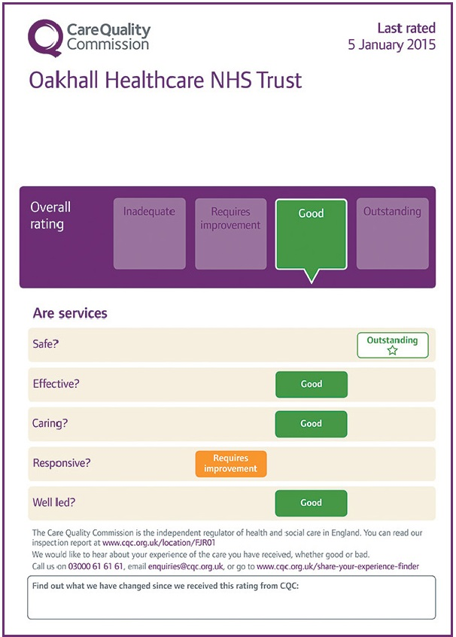
Display of ratings
Why? Public able to see rating of service quickly and easily
Where? Providers should display in prominent area in public view and on website
CQC will send a template for completion and display
CQC will check this during inspections
A Provider
Notes:
From 1 April 2015, if you have been awarded CQC ratings you must display them in each and every premises where a regulated activity is being delivered, in your main place of business and on your website(s) if you have any. This includes community premises and other premises which might not necessarily be registered with CQC (for example, premises from which you provide occasional clinics and therefore may not be registered with us as separate locations). You must always display your most up-to-date ratings.
Ratings must be displayed legibly and conspicuously to make sure the public, and in particular the people who use your services, can see them.
We also encourage you to raise awareness of your most recent ratings when communicating with people who use your services, by letter, email or other means.

Slide 7
Inspection feedback from practices
“My staff told me they found it a positive experience, as they don’t always get a chance to reflect on what we are doing.”
“For the first time in our lives, we feel that our work has been recognised and appreciated.”
“They worked very hard to ensure that the day was as stress free as possible whilst getting the information they needed.”
“We appreciate you making the process less stressful than we expected it to be!”
7

Slide 8
So far we have found…
We have published 6,028 inspection reports since we launched our approach to inspecting GP practices in October 2014. What have we found?
89% of GP practices we have inspected are providing a good or outstanding standard of care
8
Source: CQC – 1 December 2016

Slide 9
GP ratings by key question
Source: CQC – 1 December 2016

Slide 10
Outstanding characteristics
Easy to access appointments and services through several communication channels
Good and effective leadership extends beyond the manager and those values are cascaded to inspire staff
Staff training and support
Open culture – people who use services/ staff/ relatives shared views and issues
Strong links with local community
Working with multi-professional colleagues and from other organisations
Support patients and carers with emotional needs
Services empowering patients to self manage long-term conditions
Notes:
LAs –
How can you commission for these outstanding qualities?
How can you manage existing contracts to reach and value services which demonstrate these qualities?
The better the relationship between LA and CQC, and the more a LA works proactively in partnership with local providers, the better the quality of care.

Slide 11
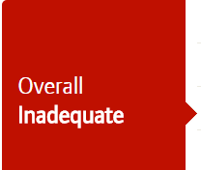
Inadequate characteristics
Weak leadership, Chaotic and disorganised environment
Isolated working, not involving other local providers to share learning and best practice
A lack of vision for the organisation and clarity around individuals’ roles and responsibilities
A poor culture of safety and learning ie. lack of learning from complaints/events analysis
Poor systems for quality improvement
Disregard for HR processes ie. DBS checks
Unsafe medicines management
Low/insufficient practice nurses or sessions
Notes:
Weak leadership and a chaotic and disorganised environment
Isolated working – not working closely with other local providers to share learning
A lack of vision for the organisation and clarity around individuals’ roles and responsibilities
A poor culture of safety and learning (for example, lack of significant event analysis or learning from complaints)
Poor systems for quality improvement (including quality audit)
Limited examples of assurance of clinical care
Disregard for HR processes (for example, DBS checks)
Unsafe medicines management
Limited access to advice and treatment
Lack of practice nurses or very low numbers of practice nurse sessions

Slide 12
Examples of inadequate care
“We identified one locum staff member who had treated patients but couldn’t provide evidence that they were medically qualified to do so.”
“We found no evidence of criminal record checks for the two practice nurses, or any of the non-clinical staff.”
“Medicines were found to be out-of-date, and requests for prescriptions had not been processed in a timely manner to ensure patients had access to their medicines.”
“There was no mechanism for the practice to seek patient feedback about services, and complaints had not been used to improve the service.”
12

Slide 13
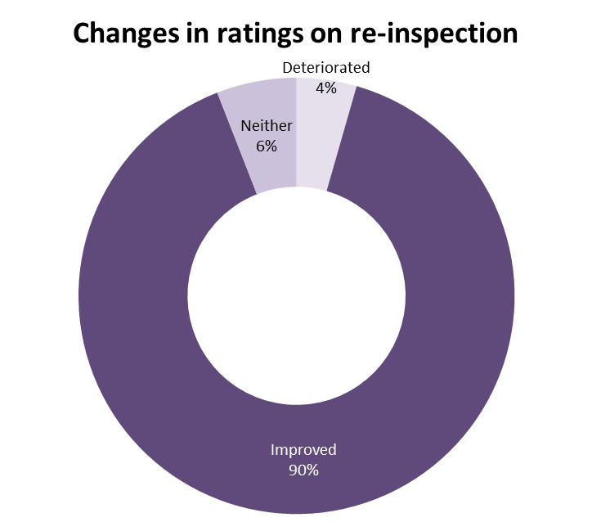
Looking at improvement
Source: CQC ratings data (based on 135 re-inspections both focussed and comprehensive
Notes:
Changes in ratings on reinspection
Based on 135 re-inspections (both focussed and comprehensive).
Improved means at least one key question improves and none deteriorate.
Deteriorated means at least one key question deteriorates and none improve

Slide 14
‘IT COULDN’T HAPPEN HERE’
THE 4 MOST DANGEROUS WORDS IN HEALTHCARE

Slide 15
Safety: key themes in poor care
Safety issues often relate to poor systems and processes, examples include:
Insufficient evidence of risk management and learning from incidents e.g. MHRA alerts poorly managed
Poor responses to patient complaint letters and failure to act on issues raised
Lack of effective and timely safeguarding and training
Poor infection control procedures
Inability to use clinical system functions to run basic searches and audits to Poor oversight of High Risk Medicine Prescribing and Monitoring.
Fridges at the wrong temperature, insufficient emergency drugs and expired medicines
15

Slide 16
Effective: key themes in good care
We’ve found many examples of good, effective clinical practice, meeting the needs of local populations, for example:
Quality improvement programmes
Coordinated referral processes
Joined up care with other healthcare providers
Strong relationships with local schools, universities, fire and benefits advisory services
These relationships support practices to deliver enhances services
Joined up models of working, benefits observed include:
Appointments outside normal working hours
Wider range of services
16

Slide 17
Caring: key themes in good and poor care
Outstanding practices were able to demonstrate, for example:
Specific support for individual population groups
Innovative programmes for certain health conditions
Flexible access to services
Of the small (but still concerning) number of practices we found to be Inadequate for caring we found:
Staff to lack compassion and respect for patients
Poor concern for patients’ privacy and dignity at the reception desk/waiting area
17

Slide 18
Responsive: key themes in good care
Practices rated as outstanding had considered the needs of its population and subsequently implemented change.
For example:
Guaranteed same-day appointments
Extended practice opening hours
Language support for non-English speaking patients
Innovation in how primary care is provided is developing rapidly:
Recently registered new GP care model using technology to provide consultation
Social enterprises are leading the way in care provision models
Demonstrate a clear vision to improve health of vulnerable and excluded groups
Work closely with services across their locality
18

Slide 19
Well led: key themes in good care
GP practices are generally well-led, with 85% rated good or outstanding
Our inspection findings show good leadership is the foundation of an outstanding organisation. Examples include:
Patients at the centre of their developments, with effective patient participation groups involved in multiple aspects of the practice’s business
Excellent staff development and support, with the development of special programmes to aid staff development or support staff in their role
The role and capability of the practice manager has an important influence, and the level of training and support for practice managers is key
19

Slide 20
Population groups
GPs typically provide good services to their population groups
Common examples of where GPs had done more to adapt their services to specific needs include:
Population group | Example
Working age people | Offering appointments outside of usual working hours (9am-5pm) and at weekends.
People with long-term conditions | Educating patients to self-manage their long-term conditions more effectively.
People whose circumstances may make them vulnerable | Being flexible in their approach to vulnerable people by offering longer appointments and allowing homeless patients to register their home address at the practice.
People experiencing poor mental health | Working collaboratively with local mental health services and improving access to psychological therapies and substance misuse services.
Older people | More than what is in the standard NHS contract. Managing beds in a care home that led to demonstrable reduction in admission to hospital and reduced days spent in hospital for elderly patients.
Families, children and young people | Offering information in age appropriate formats for young people and ensuring staff were well trained on local safeguarding processes.
20

Slide 21
Our thoughts on what would faciltitate improvement
Invest in strong governance and visible leadership, both clinical and managerial
Report all safety incidents both within the practice and externally, and embed a culture of learning among staff
Improve the consistency of quality improvement activity
Improve access to services
Consider how providers can integrate and work together to reduce variation in quality
Improve medicines optimisation through a culture of learning from medicines related safety incidents
Notes:
Report all safety incidents both within the practice and externally, and embed a culture of learning among staff
Improve the consistency of quality improvement activity
Improve access to services
Consider how providers can integrate and work together to reduce variation in quality
Improve medicines optimisation through a culture of learning from medicines related safety incidents

Slide 22
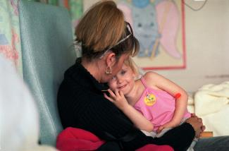
What will our strategy mean for primary care?
Reduce duplication for providers, agree actions jointly where there are risks of poor care
Extend inspection intervals for good or outstanding practices
Focus on understanding innovative models of care and areas where potential risks may emerge
Federations and other new care models: focus on well-led question, consider inspection of sample locations alongside, understanding potential risks using local data
For urgent and emergency care, including OoH and NHS 111:
inspect related services at the same time

Slide 23
Helpful resources for practices
Make sure you’ve read our provider handbook, and understand the key lines of enquiry our inspectors will focus on
Read our mythbusters for tips and further guidance
Read our outstanding practice web tool kit and consider what would make care for people who use your services outstanding
Read our ‘What to expect from an inspection’ and case studies to understand what an inspection looks and feels like
We’ve signposted all of these resources and more in our provider toolkit. Simply visit: www.cqc.org.uk/GPProvider
23

Slide 24
Support for poor performing practices
What happens when a practice enters special measures?
We will inform the NHS clinical commissioning group, and NHS area team
The Royal College of GPs provides peer support to practices, using a local turnaround team
The RCGP helps practices identify and deliver an improvement plan
We talk to the LMC
24

Slide 25
Reviews of care
Notes:
Thematic reports from March 2015 – present (in order of publication)
Celebrating good care, championing outstanding care – March 2015
This report shares good practice and includes a collection of short case studies illustrating some of the qualities shown by care providers that are rated good or outstanding overall. It also shares the views of some people responsible for care quality and what they do to drive improvement.
Right here, right now – June 2015
A national report looking at people’s experiences of help, care and support during a mental health crisis. The report is based on feedback from almost 1,800 people with experience of a mental health crisis, along with local area inspections looking at how services work together, surveys of service providers and a review of national data.
Better care in my hands – how people are involved in their care – May 2016
People’s right to being involved in their own care is enshrined in law in the fundamental standards of care. It is an essential part of person-centred care and leads to better and often more cost effective outcomes.
This report is based on newly analysed evidence from our national reports and inspection findings, as well as national patient surveys and a literature review. It identifies what enables people and their families to work in partnership with health and social care staff and illustrates this with good practice examples from our inspection findings.
A different ending – addressing inequalities in end of life care – May 2016
We spoke with people who may be less likely to receive good care – whether because of diagnosis, age, ethnic background, sexual orientation, gender identity, disability or social circumstances – to tell us about their experience of end of life care, and the barriers which may prevent them from experiencing good, personalised care at the end of life.
Building bridges, breaking barriers – July 2016
Building bridges, breaking barriers looks at how well care for older people is integrated across health and social care, as well as the impact on older people who use services and their families and carers.
Not seen, not heard – July 2016
We're calling on health services to do more for children at risk of harm. Children and young people have the right to get the care that they need, when and where they need it.
Identifying and managing clinical risks in new-born babies and infants who need respiratory support – July 2016
For this review, we have focused on the quality and variability of NHS care, to help us identify if there are gaps that need to be addressed. By doing this, we aim to identify opportunities for improvement and influence the development of clear national guidelines.
My diabetes, my care – September 2016
This review considers how well care services work together to deliver high-quality diabetes care. It also makes a number of recommendations for how health and social care commissioners, providers and professionals should work together to improve diabetes care and prevention.

Slide 26
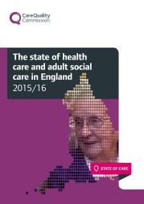
Reviews of care
More to come….
Integrated urgent care
CAMHS
Notes:
State of Care – October 2016
This year’s State of Care report shows that, despite increasingly challenging circumstances, much good care is being delivered and encouraging levels of improvement are taking place. However, the sustainability of this position is in doubt. We are also beginning to see some evidence of deterioration in quality, and some providers who are struggling to improve their rating beyond ‘requires improvement’.
Learning, candour and accountability – December 2016
A review of the way NHS trusts review and investigate the deaths of patients in England.
Inspection findings and data from other sources to build a picture of what care is like for the people who use health and social care services in two local areas in 2016:
Quality in a place reports
Purpose:
inform the public about the quality of their local services and how well they work together
show care providers and commissioners of health and care where they need to improve to serve local people better
highlight findings that show where good joint working has benefited people who use health and care services.
MENTION: New models of care – statement
NHS England's Five year forward view pictures a range of new ways of breaking down the traditional divide between primary care, community services and hospitals. As a result we are now starting to see new models of care take shape as providers work together to find new and innovative ways to provide care for people.
As part of our commitment to encourage innovation and improvements in care (as set out in our strategy for 2016-21), we have published a ‘statement of intent’, which explains how we will support and work with providers as they develop new care models.
Our supportive offer to providers is built on the following principles:
Listening and learning
Supporting innovation
Working with national regulators and system partners
You can read the full statement of intent and find out more about our plans on our website at http://www.cqc.org.uk/content/new-models-care
You can order print publications online and all full publication and summaries, can be found online

Slide 27
Not seen, not heard: Our findings
2 out of every 3 young people we spoke to said they didn’t feel involved in their care
Most areas unable to prove they are making a difference in young people’s lives
Sharing information with the right people at the right time needs to be improved
A young persons pathway from children’s care to adult services can be very difficult
Notes:
2 out of every 3 young people we spoke to said they didn’t feel involved in their care
Most areas we visited couldn’t prove to us they were making a difference to children and young people.
Health staff need to improve how they share information with the right people at the right time
When young people are old enough to leave children’s care services it can be very difficult for them to move to adult services.
http://www.cqc.org.uk/content/not-seen-not-heard

Slide 28
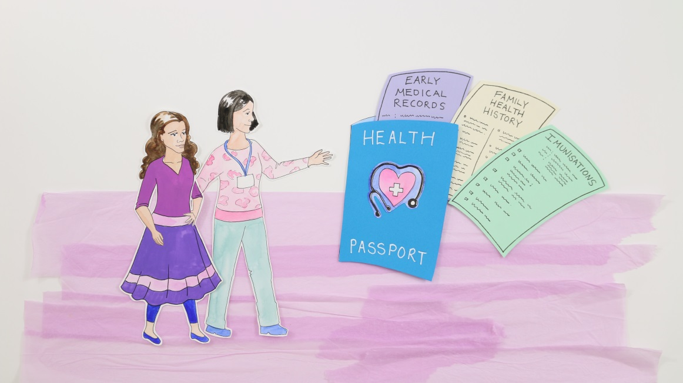
Not seen, not heard: Our recommendations
Children and young people must be actively engaged in their care
Services must ensure their focus is on outcomes
More is done to identify children at risk of harm
Children and young people must have access to the emotional and mental health support they need

Slide 29
Get involved
Respond to the first consultation on our next phase of inspections until 14 February 2017
www.cqc.org.uk/nextphase
nextphase@cqc.org.uk
@CareQualityComm using #CQCnextphase
To respond to the NHS Improvement joint consultation on Use of Resources and the ‘well-led’ domain, please follow the link on the above web page.
Notes:
CQC will be supporting an NHS Improvement will be consulting on Use of Resources and the ‘well-led’ key question for NHS trusts
In Dec consultation we will not be describing proposed changes for Independent hospitals -the approach for this sector will be developed when we have completed the majority of comprehensive inspections so we understand the sector and the quality of care it provides (but there are relevant areas and this will be highlighted)

Slide 30
Find out more
Read the monthly bulletin for primary care providers
Sent to all providers and registered managers, or sign up through our website
Join our provider and public online communities
Visit our new guidance page for GP practices www.cqc.org.uk/gpintroguide
Find all of the above and more at: www.cqc.org.uk/GPProvider

Slide 31
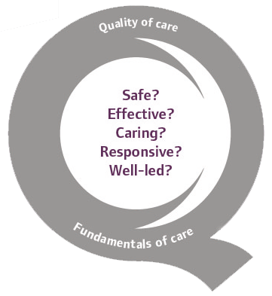
Thank you
www.cqc.org.uk
enquiries@cqc.org.uk
@CareQualityComm
31

