Slide 1
Dr Arvind Madan
Director of Primary Care
Deputy Medical Director NHS England
www.england.nhs.uk/gp
www.england.nhs.uk/gp
8.3.17

Slide 2
General practice provides safe, high quality and efficient care, with very high levels of patient satisfaction. It has a unique and vital place in the NHS…
Holistic perspective understanding the whole patient not just a disease
Accessible, personal care built on a relationship from cradle to grave
First port of call and central point of care for all, for life
Comprehensive skills to diagnose & manage almost anything
Community based responsible for prevention and care of a registered population
Personal and population-orientated primary care is central …
if general practice fails, the whole NHS fails. Simon Stevens, General Practice Forward View

Slide 3
UNDER
INVESTMENT
WORKFORCE CHALLENGES
The problems
UNFUNDED WORK RISING DEMAND BUREAUCRACY
INADEQUATE INFRASTRUCTURE

Slide 6
Overall new investment is a minimum extra £2.4 billion pa by 2020/21
£9.6
billion/year
2015-16
£12
billion/year
2020-21
14% real terms increase
vs 8% for the rest of the NHS
(plus CCG increases)
One off Sustainability and Transformation package >£500M over 5 years
Notes:
Our overall new investment to support general practice is a minimum extra £2.4 billion a year by 2020-21:
Investment will rise from £9.6 billion pounds a year in 2015-16 to over £12 billion a year by 2020-21 - over 10 percent of NHS England healthcare budget. This could be increased further at local level, depending on the pace of change at which care and resources shift from hospitals to community and primary care settings.
Represents a 14 percent real terms increase, almost double the 8 percent real terms increase for the rest of the NHS.
A one off Sustainability and Transformation package of investments, totalling over half a billion pounds over next five years.
We’ll continue to make capital investments, with estimated likely capital investment over the next five years to reach over £900m.
Achieve more joined up, high quality GP services, supporting practices to deliver new models of care.

Slide 7
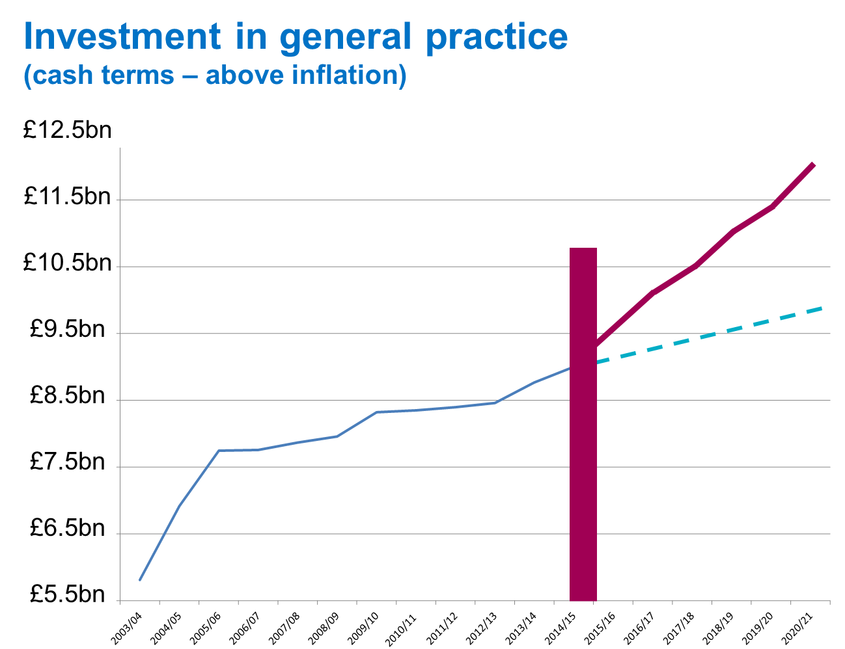

Slide 8
Stabilise and Improve Resilience
Vulnerable Practices Scheme
£10m to support 900 identified GP practices in difficulty
Permissive approach e.g. no matched funding
Diagnostic and improvement support for 600 practices
£4.6m spent and remainder to be spent this calendar year
Practice Resilience Programme
£40m four year programme with £16m for this financial year
Similar permissive approach to individual and groups of GP practices
Over 1,000 practices this financial year
£8m each year for next three years

Slide 9
Already actioned
Extra £33m included in 2016/17 contract
Repeat winter payments scheme for OOH in 2016
Next steps
Out of Hours
Work on new scheme for OOH support with BMA
In hours
Payment to all practices in April 2017 and 2018 based on average indemnity increases
Longer term
GP Indemnity Review Group to look at cover for new members of the workforce
and other more radical options

Slide 12
Expand the Medical Workforce
5,000 Net WTE doctors in general practice by 2020/21
Encourage
Recruitment
Medical schools
Health Education England increasing training places
250 Post-CCT fellowships
Major campaigns
CSU marketing support
International recruitment
Make GP
attractive again
Reduce workload
Induction & Refresher scheme
Bursaries in under-doctored areas
Retainer Scheme
Leadership training opportunities
Training Hubs
Retention
Flexible career schemes
Career coaching for GPs
GP Health Service
Notes:
Increase in GP training places to 3,250 a year to support overall net growth of 5,000 extra doctors by 2020 (compared with 2014).
Major recruitment campaign in England to attract doctors to become GPs, supported by 35 national ambassadors and advocates promoting the GP role.
Major new international recruitment campaign to attract up to an extra 500 appropriately trained and qualified doctors from overseas.
250 new post-certificate of completion of training (CCT) fellowships to provide further training opportunities in areas of poorest GP recruitment.
Attract and retain at least an extra 500 GPs back into English general practice

Slide 13
Develop the workforce
5,000 additional staff by 2020/21
NURSES
PHARMACISTS
Support with return to work
Improved practice placements
£15M to be invested
Current £31m to pilot 470 pharmacists in >700 practices,
Plus new £112m to extend by a pharmacist per 30,000 patients
For an additional 1,500 pharmacists by 2020
Clinical pharmacists in 111 hubs
PRACTICE MANAGERS
Expanded national network
£6M on development
PHYSICIAN ASSOCIATES
PARAMEDICS & PHYSIOS
New Care Models
1000 to be trained
Regulatory and indemnity enablers
MENTAL HEALTH
3000 Therapists for long-term physical conditions
Notes:
A minimum of 5,000 other staff working in general practice by 2020/21. This five year programme will include:
Investment in an extra 3,000 mental health therapists to work in primary care by 2020, which is an average of a full time therapist for every 2-3 typical sized GP practices.
Current investment of £31 million to pilot 470 clinical pharmacists in over 700 practices to be supplemented by new central investment of £112 million to extend the programme by a pharmacist per 30,000 population for all practices not in the initial pilot – leading to a further 1,500 pharmacists in general practice by 2020.
Introduction of a new Pharmacy Integration Fund.
A general practice nurse development strategy, with an extra minimum £15 million national investment including improving training capacity in general practice, increases in the number of pre-registration nurse placements, measures to improve retention of the existing nursing workforce and support for return to work schemes for practice nurses.
Investment by HEE in the training of 1,000 physician associates to support general practice.
£6 million investment in practice manager development, alongside access for practice managers to the new national development programme.
Introduction of pilots of new medical assistant roles that help support doctors, as recommended by the RCGP.
National investment of £45 million benefitting every practice to support the training of current reception and clerical staff to play a greater role in navigation of patients and handling clinical paperwork to free up GP time.

Slide 16
Simplify reporting and regulation
Streamline the payment systems
Move away from micro-incentives
Demand
Management
GP PRACTICE
Self-help and Patient Online
Better sign posting
Care navigation
Social prescribing
Minor ailments
Remote triage/care
Open access AHPs
Reformed 111/Urgent Care
Practice Resilience Programme
GP Development Programme
10 High Impact Actions
Upskilling staff
Capacity Planning tools
GP Health Service
HOSPITAL
Greater Specialist Support
Changes to the Standard Contract
Collective
working and
MCP contract
Access hub
Community services
Notes:
Workload is the number one issue raised by practices. Action needs to be taken nationally to reduce bureaucracy, and there needs to be local support to help practices manage demand in different ways.
New standards for outpatient appointments and interactions with other providers – reduce the burden of hospital correspondence and GPs having to manage tasks for patients under the care of the hospital. Improving the interface between hospitals and general practice will begin with changes to the NHS Standard Contract from April 2016
Accelerating paper free at the point of care within general practice – assisting primary care organisations to become ‘paper free’ not just within practices but across the wider health care system through interoperable systems
Promoting best practice – NHS England has begun developing resources including case studies and practical implementation resources, spreading the existing innovations benefitting some practices but unknown to others. A new audit tool for all practices to identify ways they could reduce appointment demand.
Mandatory training – NHS England will work with relevant bodies to review and reduce these requirements to ensure a far more proportionate approach is taken. We will also keep in mind the impact of appraisal and revalidation requirements in the analysis
Support for more integration across the wider health and care system – social support, leadership support and work and health for primary care staff
Support for a move to a maximum interval of five yearly CQC inspections for good and outstanding practices (by December 2015, CQC had inspected almost a third of practices, finding the vast majority (86 percent) are providing care that is good or outstanding)
Building practice resilience: £10 million investment to support most vulnerable GP practices is now supplemented with the introduction of a new three year £40 million practice resilience programme – moving away from ‘struggling practices’ to practice resilience
Improving and simplifying transparency of information: A set of key ‘sentinel’ indicators will be published on My NHS.
NHS England has agreed to undertake a review of QOF and the AUA DES with the GPC
Streamlining payments, reporting requirements and information – Reporting requirements and information, and streamlining the payment system. We will introduce a simplified system for how GP data and information is requested and shared across NHS England, CQC and GMC. This will be backed by a programme of work to cut the bureaucratic burden of oversight.

Slide 19
Estates
Estates and Technology Fund - prioritisation and pipeline
Over 800 schemes in pipeline from 2016-19 (subject to due diligence) on top of 560 already completed
BMA approved lease with NHSPS properties
Project Management support to speed up delivery
100% reimbursement of premises costs in certain circumstances (rather than up to 66%)
Fund £7M Stamp Duty for NHS Property Services tenants
Compensate VAT where the landlord has chosen to charge VAT
Transitional funding for significant rises in facilities costs
Notes:
If we are to transform the way care is delivered, we have to improve our estate and infrastructure faster. We will provide support in a variety of different ways:
Estimated £900m public sector capital over next five years
New rules on premises costs to be introduced to enable 100 percent reimbursement of premises costs where appropriate
New offer for practices who are tenants of NHS Property Services for NHS England to fund Stamp Duty Land Tax for practices signing leases from May 2016 until the end of October 2017, and compensate VAT where the ultimate landlord has chosen to charge VAT.
Transitional funding support for practices seeing significant rises in facilities management costs in next 18 months
Over 18 percent increase in allocations to CCGs for provision of IT services and technology for general practice.

Slide 20
Health Analytics
Technology
HOSPITAL
Online & Phone triage
Clinician to clinician
Increase Self-care
GP PRACTICE
NHS.UK (NHS Choices)
Patient Online
Advice & Guidance
GP Connect
GP2GP
Decision Support software
Approved Apps & Wearables
Remote signposting
Wi-Fi
HR/
Finance
Rota plan
E-Referral
111Online (pilots)
Unified Coding
SCR in pharmacies by March 17
EPS
E- discharge
18% increase in GP IT funding

Slide 23
Care Redesign
General Practice Development Programme
(£30M over 3 years)
Innovation Spread
10 High Impact Actions to release time for care
Regional GPFV roadshows
Local High Impact Actions showcase events
Webinars
Web resources
Network of experts
Time for Care
Bespoke 9 month action learning programmes with expert input - aligned to local initiatives
Rapid on-site Lean redesign support from The Productive General Practice
Building Capability
Training to build change leadership capabilities – up to 400 places / year
Support RCGP Federation Network and NHS Collaborate
Practice Manager networking and development
Sign up at www.england.nhs.uk/gpdp

Slide 24
Where are we now?
GPFV scrutiny and architecture in place

Slide 25
Where are we now?
Investment secured and in planning guidance
Indemnity till April 2019 (OOHs ongoing)
Vulnerable Practices Scheme
Practice Resilience Scheme
International Recruitment Pilots
491 Clinical Pharmacists + Phase 2 now
Practice Manager Training Consultation
Induction & Refresher/ Retainer Schemes
£20K Bursaries
250 Post-CCT Fellowships
Medical School places increase
Training hubs
Standard Contract Changes / Interface Group
National GP Health Service from Jan 2017
GMC / CQC / NHSE joint work
Medical Assistant & Care Navigation
Pipeline of 800 premises schemes
BMA Approved Lease with package
Nearly all practices offer Patient Online
SCR in pharmacy
Issued £45m allocation to CCGs for 2017/18 onwards for online consultations

Slide 26
General Practice Development Programme
Leadership Training Opportunities (400 pa)
111 Online Clinical Assessment Hubs
Capacity Planning Tools being rolled out
Expansion of capacity via Access Hubs
Flexible Careers Scheme
MCP Framework and voluntary contract

Slide 27
Improving Capacity in General Practice
Build on the 57 GP Access Funds covering 17M patients towards national coverage of access hubs by March 2019
CCGs to commission hubs from practice groupings/OOH/urgent care providers (or a mix)
National requirements
£6/patient to commission
£138M in 2017/18 and £258M in 2018/19 as recurrent funding
Can be used for in and out of hours capacity to support practice resilience
Receptionists can book appointments
30 mins/ 1000 patients initially
1.5 hours per weekday
Weekend provision locally-tailored
Use of digital approaches
Effective service integration
Urgent and Emergency Care Review
NHS 111 will be a single entry point to access 111 and GP OOHs
Containing GPs and other health professionals with access to medical records
On track to cover 38% of population by April 2017 → Full coverage by April 2020

Slide 28
Pharmacy and the future
How pharmacy will change
Overall aim is to better integrate pharmacy in to the NHS system, make better use of pharmacists’ skills and help relieve pressure on general practice
491 clinical pharmacists in GP practices, with 1500 more to come by 2020
Community pharmacists more involved in monitoring of LTCs, especially in care homes
60 pharmacists in urgent care/NHS111 hubs and 150 pharmacists in care homes to support medicines optimisation
Encourage more patients to sign up for Patient Online, so they can request repeat scripts online
Target for 80% of all prescriptions to be done using the Electronic Prescription Service
Patients’ Summary Care Records will be available in every pharmacy
All community pharmacies to use NHS Mail
Urgent medicines supply service: direct referral from NHS111 to community pharmacies to supply urgent repeat prescriptions, to reduce pressure on GP OOH services
Urgent minor illness care pilot: direct referral from NHS111 to community pharmacies for minor illnesses, to free up GP time
Strengthened partnership working between RCGP, BMA and the pharmacy profession to unravel boundary issues between the professions

Slide 29
Collaborative Working Options MCPs feel like a distant concept – how do we progress now?
Consider becoming an MCP
Collective provision of services for CCG
Access and diagnostic hubs
Group Education and training
Prevention, self-care & social prescribing
Integrated 111, Out of Hours and Urgent Care
Economies of scale e.g. group buying
General Practice Development Programme
Collective recruitment e.g. GP Career Plus
Integration with community and specialist services
Practices form natural groups e.g. 30-50K
Sharing staff & resources to build resilience
Collective estate and IT planning
Work closely with community pharmacy
Place & population based-care
Increasing collaboration New approach to care

Slide 30
What is a Multi-speciality Community Provider?
Key Features
CCG commissioned voluntary contract
Place-based and population-based provision > 100K patients (30-50K units)
Focus on prevention, self-care and use of community assets
Wider range of specialists developing integrated patient pathways
Greater resilience across practice groups
Greater career opportunities for all staff
Social
care
Mental Health
Community services
GP
New organic business models in 10-15 year contracts (with right of return)
1. Virtual: Alliance contract over existing
2. Partially Integrated: GMS + Community Services
3. Fully Integrated: One budget, one team, one service
Intensive work with 6 aspirant MCPs
Outpatients

Slide 31
Where are we going?
Voluntary sector: The 3rd workforce
Social Prescribing
Minor ailment scheme
Open Access Services e.g. physio
Empowered to
Stay Well and make
well-informed
choices
Care navigation
Additional GP / nurse capacity
Locality MDTs
Specialist Clinics
Redirection
Fewer patients
see the GP
Consider
Self Care
New Consult Models
Attend
A&E
NHS.UK
Apps and wearables
Phone triage
and care
Online triage
and care
Advanced Nurse Practitioner
Clinical Pharmacist
Specialist support
Patient Activation
for LTCS
111 Online and 111 Hubs
Physician Associate
Mental Health Therapist
Enhanced Advice and Guidance / Consult
Community pharmacy
Access to records via Patient Online

Slide 32
www.england.nhs.uk/gp

Slide 33
Further information is available on the NHS England website
www.england.nhs.uk/gp
www.england.nhs.uk/gp
8.3.17

