Slide 1
MCP
Clinical Service Delivery
Dialogue Session
28th February 2018

Slide 2
Session Format
# | Time | Topic
1 | 1300-1335 | Overarching approach to service and outcome delivery 15 min presentation 20 min Q&A
2 | 1335-1405 | Communications Hub & Community Nursing to include MDTs 10 min presentation 20 min Q&A
3 | 1405-1435 | Long Term Conditions incl respiratory and diabetes 10 min presentation 20 min Q&A
4 | 1435-1450 | MSK 5 min presentation 10 min Q&A
5 | 1450-1520 | Children and Young Peoples incl 0-19 10 min presentation 20 min Q&A
6 | 1520-1540 | Approach to other clinical areas in scope 10 min presentation 10 min Q&A
7 | 1540-1600 | General Q&A

Slide 3
Delivering an MCP
A new mind set when delivering a population health contract
Significant redesign of clinical pathways
New ways of working for all staff
New ways of engaging and interacting with the population of Dudley
Investment at a time of austerity
An ambitious 15 year plan whilst ensuring Year 1 is sustainable and all the services in scope “land” safely at Go Live.

Slide 4
Purpose of our presentations
Clear proposals for the way the MCP will operate and its fundamentally new approach to healthcare delivery
How it will deliver the three “Pillars” of the MCP - Access, Continuity and Co-ordination
The key enablers it will put in place
A clear prioritisation strategy
Support to Primary Care
Some examples of key service/operational changes
Clarification of its approach to all services in scope, the rationale and its future plans for each

Slide 5
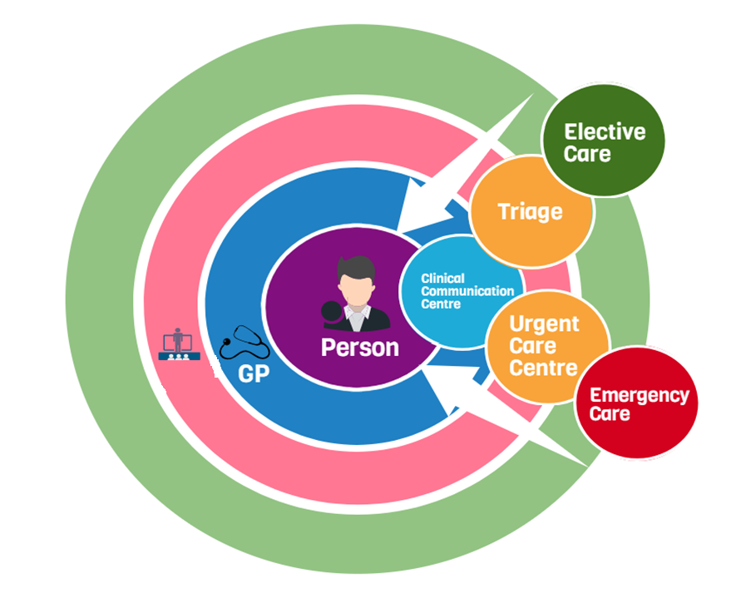








Integrated Community Teams
ICT

Slide 6

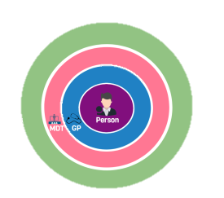
10 ICTs in 5 localities
Resources allocated based on need
If operationally and clinically functional management at sub-locality level
Majority of community staff employed by the MCP
Sub-contracts will require commitment to “teams without walls”

Slide 7
Access
The MCP will increase the operational capacity of existing resources (including staff) through:
  Improved efficiency and effectiveness
  Pathway transformation and redesign
  Reduced duplication and waste e.g. lean methodologies
  Utilisation of tools and technologies e.g. dependency and workforce allocation tools, shared clinical record, patient portals etc.
The MCP will use this capacity to:
  Improve access
  Improve Outcomes
  Support sustainability
The MCP is required to:
  Reduce waits
  Reduce variation
  Improve calls, visits, diagnostics & treatment response times
  Improved flexibility in the time and mode of access

Slide 8
Continuity
The MCP will deliver this through:
  Ensuring all staff delivering services for the MCP are working to the outcomes framework
  Supporting clinician decision making through a shared clinical record
  Integrating LTC specialist staff into multidisciplinary/ Integrated Community Teams (either through management structures or contractual pathway protocols)
  The MCP will prioritise its initial transformation efforts on community nursing, case management, diabetes, respiratory and End of Life patients/pathways
The MCP is required to:
  Ensure appropriate diagnosis and Long Term Condition management
  Provide joined up care for people with continuing needs
  Deliver the evidence-based outcomes framework

Slide 9
Co-ordination
The MCP will deliver this through:
  all staff working to the outcomes framework
  shared clinical record
  Integrating LTC specialist staff
  Improve communication throughout and across clinical pathways, integrate with Primary Care systems, Communications Hub and ICTs
  Use online tools to support empowering patients/ family/ carers to self-manage
  Prioritise its initial transformation efforts
The MCP is required to:
  Ensure care plans are constructed with all relevant parties and co-produced with the individual
  Ensure patients with multiple co-morbidities, those with frailty and those nearing the end of life, get better coordinated care and that services that support them work closely together
  Reduce avoidable admissions, DTOCs, and social isolation
  EOL care in the place of choice

Slide 10
Key Enablers
Shared Outcomes
Shared clinical record
Shared MCP “culture”
New Management and Operational structures
Clinical pathway transformation/ redesign

Slide 11
Support to Primary Care
Integrated Community Teams (ICTs) at the 10 sub-locality areas
ICT staff will be employed directly by the MCP
Each GP practice will have named contacts for key community services
Ensuring all staff delivering services are working to the shared outcomes within the Dudley Quality Outcomes Framework
For all services Directly provided by the MCP deploy a clinical system that can integrate with Emis Web.
  visibility of all interventions undertaken by both Primary Care and the MCP
  This will facilitate a new level of communication to support care planning, referrals, advice and guidance and capacity management.
Support clinician decision making through a shared clinical record
Integrate LTC specialist staff into ICTs
OD strategy will ensure the workforce are engaged, involved and motivated
Communications Hub and its on-going enhancement
A clear process for the assessment and development of Full Integration within the MCP

Slide 12

Questions

Slide 13
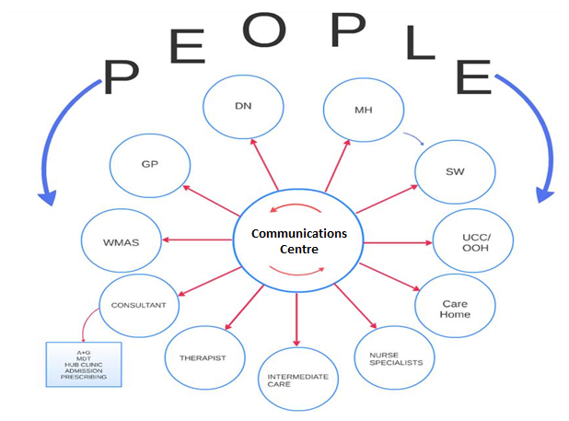
Communications Centre

Slide 14
Communications Centre
Access via one task / email / number
Response co-ordinated by a care navigator
Passed to most appropriate clinician
Clinician can view whole patient record
Disposition
  Advice and guidance
  Teleconsultation
  Referral for non-urgent appointment (DN /Case manager/ HF/ DRAS /DSN / Macmillan/ AHP’s/ Therapies/ Social services)
  Urgent / non-urgent visit (Community Response Team / OPAT)
  Respite or Admission (social and nursing) “Urgent Care Bureau”

Slide 15
Communications Centre - benefits
What are the benefits to patients/residents?
  Fewer inappropriate hospital attendances / admissions
  Care at home more frequently
  Right care
  No need to repeat their history, as all professionals can see record.
What are the benefits for staff?
  Nurses & AHPs see full data needed to triage well.
  Greater role for nurse / AHP decision making and leadership -> job satisfaction.
  Great two-way communication with GPs and community specialists
  Bespoke recruitment and training needed for navigators
Impact on outcomes
  Fewer hospital admissions
  Fewer breaks in care pathways
  Earlier appropriate interventions prevent deteriorations / crises

Slide 16
Communications Centre - how
Creates clinical capacity by using skilled non-clinical staff
Utilises MCP clinical system that integrates with Emis Web
Increases efficiency through streamlined processes e.g. use of tasks not waiting for call to be answered
Economies of scale e.g. opening times, response times, team resilience
Fit for purpose ICT e.g. telephony
Phased approach supports safe transfer, scale of investment requirements and benefits realisation

Slide 17
Communications Centre – opportunities
Care navigation for public (with 111)
Medicines management (with POD)
Clear care plan for all frail patients
Referral management
Unified safeguarding
Integration with SW / police / Integrated+ / chaplaincy /Job Centre
Targeted public health campaigns
  Screening / immunisations / alcohol / lifestyle

Slide 18
10 MDTs
A Local Team, for around 30,000 patients
1 Locality Lead GP
1 Care coordinator
1 – 5 Practices
Nursing teams (DN’s, Case manager, MH nurse, Specialist nurses)
Therapists (OT, PT, SALT, podiatry)
Consultant support
Foundation of the new Integrated Community Teams

Slide 19
Questions

Slide 20
Respiratory
Where are we now?
Well educated Healthcare Professionals with shared template, shared treatment guidelines and community support
Disjointed teams in community working in silos
High admission rates
High re-admission rates
Vey high number of respiratory patients dying in hospital

Slide 21
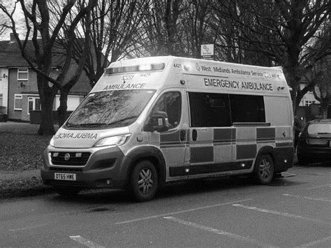
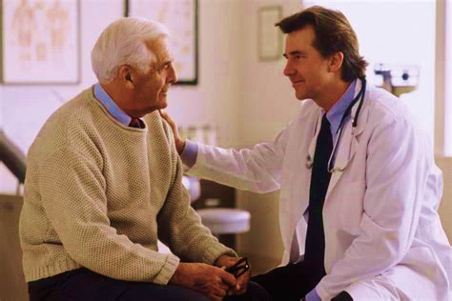
What do I do with a patient who exacerbates or I am concerned about a patient on maximum therapy or may be End of Life?
CURRENT
MCP
Direct Access clinics for advice and management
Currently confused – dial 999

Slide 22


What do I do with complex patients with multiple problems or who may be nearing End of life?
CURRENT
MCP
Respiratory MDT meetings
2 per practice per year.
Identify complex palliative patients and then plan further management.
Confused/limited support- dial 999?

Slide 23
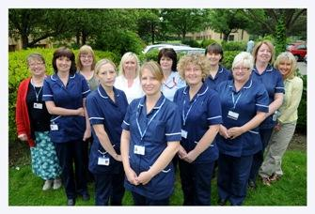
Confused about who will support my patient when they exacerbate or when near End of Life?
CURRENT
MCP
Who do I call?
?Dudley Respiratory ?Assessment Service
?District nurse
?Long term conditions team
?ANP
Confused- dial 999!
Community Respiratory Team- one team contacted through Communication Centre

Slide 24
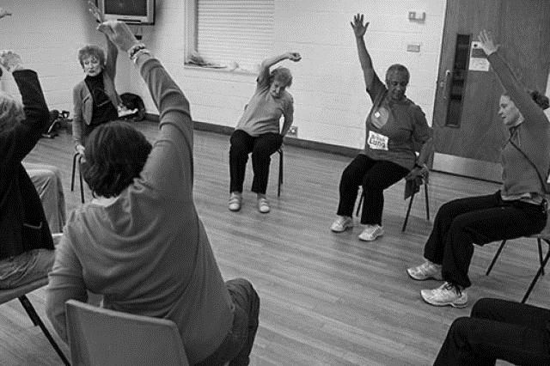
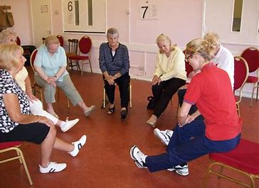
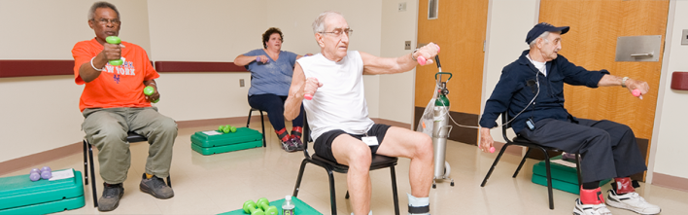
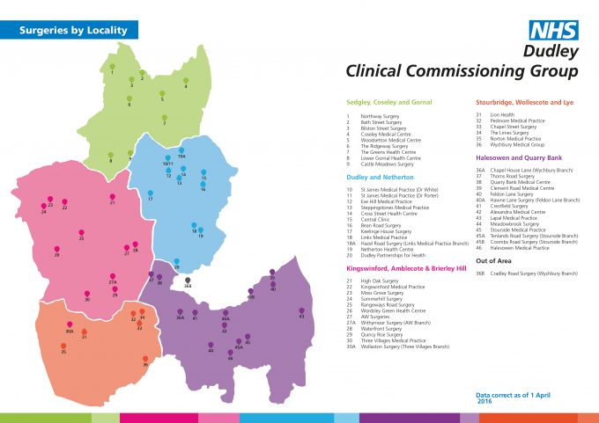
Exercise is vital to improve my patients condition- pulmonary rehabilitation proven to support and improve QOL
CURRENT
MCP
More sites
Rolling programme
Rehab for housebound
Taster sessions
Maintenance programme
Currently limited to few sites.

Slide 25
Respiratory - benefits
MCP gives HCP opportunity to manage patients with Respiratory disease better by identifying patients that need support and EOL care through practice MDT’s.
MCP gives us the opportunity to provide continuity care- single community team gives continuity care when stable and with a remit to support patients during EOL.
MCP gives HCP opportunity to manage patients who exacerbate better with support community teams and direct access consultant clinics.
MCP gives us the opportunity to improve patient care by better access to services-diagnosis/education and pulmonary rehabilitation.

Slide 26
Diabetes – service changes
Present
  Secondary care based
  Access only via referral to hospital
  Minimal education/ sporadic
Future/ MCP
  Diabetes MDT/Virtual clinic with consultants and DSN giving targeted system wide support both in social and health support
  Newly diagnosed offered range of education services
  GP practice to review twice a year: annual and 6 mth review
  Any complications/ issues refer into MDT process running every 3 months.
  Use of advice and guidance
  Access: hotline for clinicians , in future for patients, named DSN / consultant/

Slide 27
Diabetes - benefits
What are the benefits to patients/residents?
  Smooth transition from primary to MCP team/ secondary care
  Improved communication computer systems integrated: less duplication
  Better control = less complications = less hospital admissions
  Community team will enhance continuity of care from diagnosis to progression of complications and levels of control
  Increased education for type 1 and 2 diabetes to include potential web-based programmes
  Provide tools and information to promote confidence of self care and management of condition
  Innovative consultations ? Group work
What are the benefits for staff?
  Rewarding to see improved care via a shared care approach
  Better access to help
  Use of EMIS/computer
  MDTs: quarterly for each practice
  Shared work Increased job satisfaction
  Mutual outcome across whole of MCP so all working to same agenda

Slide 28
Diabetes - Outcomes
Impact on outcomes
  Reduction in admissions with acute emergencies
  Improved patient satisfaction
  Fewer breaks in care pathways
  Empowering patients to make informed decisions about their health management
  Earlier appropriate interventions prevent deteriorations / crises

Slide 29
Questions

Slide 30
MSK service - summary
Access
  central assessment hub, self referral, First Contact
Single Integrated service
  OAS, Physio, Orthopaedics, Rheumatology, Pain
Fast track surgical pathways
Community based Rheumatology
“De-medicalised” Pain service

Slide 31
MSK - benefits
What are the benefits to patients/residents?
  See right service first time
  Reduce waiting times for quicker recovery and re-enablement
  Improved outcomes
  Consistent messages
What are the benefits for staff?
  30% of GP workload is MSK that could be managed better
  First Contact Physiotherapy in GP Practices – collaborative working
  Improved advice & guidance.
  Opportunities for developing new skills Non-Medical Prescribing + First contact
  Single integrated multidisciplinary team – clear processes
  Increase opportunity to work directly with consultants and physios
  Easier for GPs – single entry point into further care

Slide 32
MSK - how
Control and manage the flow via MSK Triage that processes all MSK referrals & Self-Referral from patients
Allocate patients efficiently to correct clinician
Seamless communication within service for advice or onward management
Utilises MCP clinical system that integrates with Emis Web
Reduction in unnecessary diagnostics from Primary Care.
Manage outlier for corticosteroid injections
Increased conversion rates from orthopaedic consultant clinics to surgery
Reduce variation in delivery of patient pathways across acute, community and private physio settings
Phased approach supports safe transfer and benefits realisation

Slide 33
MSK - Phasing
Day 1
  Triage Assessment
  Self Referral
  First Contact
Long term
  Rheumatology
  Pain

Slide 34
Questions

Slide 35
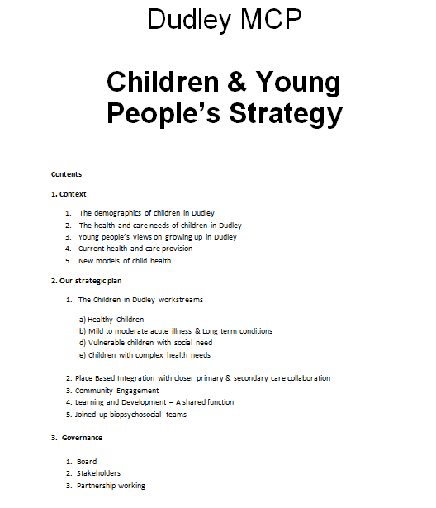
Children & Young People’s Strategy
Context
Our Strategic Plan
Long-term workstreams
Place based integration
Community engagement
Governance
Builds on existing

Slide 36
A whole population approach

Slide 37
Acutely mild-to moderately unwell child
Parent information and primary care training tools for the six most common reasons for attendance at A+E and admission
Better diagnosis of childhood illnesses
More appropriate use of ED / PAU services due to better diagnostic / prognostic accuracy – reduced admissions/ costs in system
More care closer to home preserving a child’s social and family support
More holistic care approach across mental / physical health domains

Slide 38
Mild to Moderate - benefits
What are the benefits to CYP/parents/residents?
  Better joint care planning between CYP / Parent and medical professional - inclusion
  Better continuity of care as mostly based in Primary / Community care setting
  More care closer to home preserving a child’s social / educational and family support
  Less stress for CYP by avoiding hospital admission etc.
What are the benefits for staff?
  Greater job satisfaction – feeling you are offering a better service
  More transparent system leadership and support
  MDT environment a safer / more supportive environment in which to work
  Better training and development opportunities

Slide 39
Integrated 0-19 universal service
Health visitors, school nurses, support staff and administrative support
Linked to primary and secondary care, early years, childcare and educational settings, through locally based teams and nominated leads
Co-location of staff to support a truly integrated service
Use of Assistant Early Years practitioners across the 0-8 age group recognising their unique skills
MDT integrating the work of CAMHS, Adult Mental Health, Social and Health care and providing a system wide approach to healthcare improving early intervention and targeted support

Slide 40
0-19 - benefits
What are the benefits to patients/residents?
  A seamless service across the 0-19 age group which means there will be no ‘wrong door’ for children, young people or families
  A service that promotes an integrated approach to improving child and family health locally, including leading partnerships with early years settings, schools and other partner agencies including social care
What are the benefits for staff?
  Staff will be able to undertake additional qualifications to be able to work across the 0-19 service
  Greater job satisfaction in delivering holistic care

Slide 41
0-19 - Outcomes
Impact on outcomes
  Increased satisfaction for children, young people and families due to greater awareness of service
  Improved access to service by way of locally based integrated teams
  Increased co ordination across the 0-19 pathway by removal of a false barrier at school entry
  Encourage closer working with social care with enhanced MDT provision across the borough

Slide 42
Questions

Slide 43
Other services delivered Directly by the MCP
Prescribing - Transfer staff from CCG
CHC and Intermediate Care - Transfer staff from CCG. Contract with current providers
Dermatology - Tier 2 community service
Primary care mental health/IAPT

Slide 44
Indirectly provided services (Day 1)
Services will integrate with Integrated Community Teams and/or part of sub-locality MDTs
MCPs supply chain contracts will require appropriate participation and contractual commitment to the “teams without walls”
MCP is committed to supporting third sector participation in MDTs e.g. Link Workers
MCP supply chain will be required to participate in Dudley Interoperability solution

Slide 45
Indirectly provided services –Providers (Day 1)
Mental Health & CAMHS DWMH
Direct Access Diagnostics DGFT
Learning Disabilities BCPFT
Urgent Care Malling Health
Outpatients
(excl. MCP direct provision) DGFT
Substance Misuse CGL etc.
Sexual Health DGFT & Primary Care
Wellness Service Solutions for Health
Terminations BPAS & Marie Stopes

Slide 46
Questions

