Slide 1
Appraisal 2018-19: a ‘soft re-boot’
RCGP meeting
27 September 2018

Slide 2
The context
Revalidation second cycle well under way
Appraisal and revalidation processes well embedded
Prevailing issues: resources, workload, morale, service transformation
Paterson, Bawa-Garba, Gosport.
Pearson Report, perceived ‘burden’, ‘skewed focus’

Slide 3
As a result
Is it time to shift the focus from refining processes to maximising the benefits of appraisal – a ‘soft re-boot’?

Slide 4
Broadly:
Diminish the mechanics…
…develop the learning

Slide 5
What attributes do we want in our doctors?
Good, safe, professional, resilient, confident, compassionate, principled, practical, healthy, diligent, kind doctors
That is how it leads to better patient care.

Slide 6
A rule of thumb:
A good appraisal is felt to be useful by the doctor.

Slide 7
‘…insightful and helpful appraisal…’
NHS Trust Responsible Officer, 2018

Slide 8
‘Helpful and enjoyable appraisal – are they allowed to be that?’
NHS Responsible Officer, 2016
What’s your story?

Slide 9
Can we move from:
‘I need to postpone my appraisal because I am under a lot of pressure’

Slide 10
To:
‘I need my appraisal because I am under a lot of pressure’

Slide 11
Products to help:
ROAN Information Sheet: Minimising paperwork, maximising benefit
Appraisal Preparation Guide – all doctor/GP

Slide 12
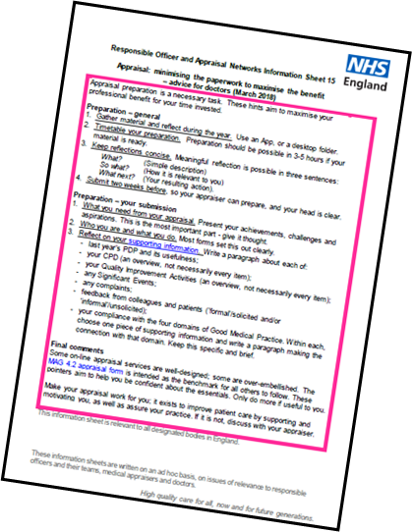
1. ROAN Info Sheet 15: Minimising paperwork, maximising benefit
Preparation strategies, concise reflection, ‘3-5 hours to prepare’
Essentials in the submission
Avoid over-embellished appraisal vehicles
Discuss things if the appraisal does not feel useful.

Slide 13
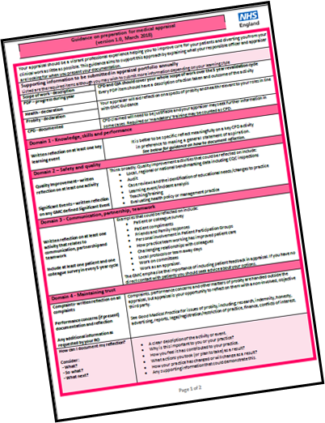
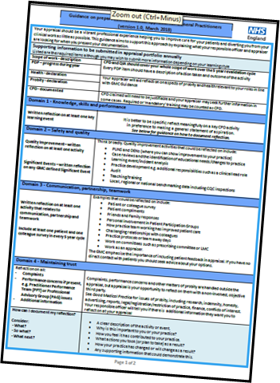
2. Appraisal Preparation Guide
‘All-doctors’ (pink) and ‘GP’ (blue) versions (minimally different in the examples offered only)
A two-side aide-memoire for doctors; helpful for appraisers too
Especially helpful for the reflection on GMP domains: specific reflection on an activity is preferable to general statements of aspiration
A short guide to reflection – especially useful for ‘non-reflecters’ by nature
A helpful glossary for those for whom this is not bread and butter activity.

Slide 14
What is this all making room for?
What are the issues you would find most useful to discuss today?
Achievements, challenges and aspirations
…identify the doctor’s agenda.

Slide 15
Thoughts:
Does this resonate?
What can we do to advance it if so?

Slide 16
Useful links
Medical Appraisal Guide
https://www.england.nhs.uk/medical-revalidation/appraisers/med-app-guide/
Doctor’s Medical Appraisal Checklist
https://www.england.nhs.uk/revalidation/doctors/doctors-medical-appraisal-checklist/
Improving Inputs to Medical Appraisal
https://www.england.nhs.uk/revalidation/appraisers/improving-the-inputs-to-medical-appraisal/

Slide 17
The GMC agree:
Taking Revalidation Forward - the Pearson review
Five GMC Priorities:
Make revalidation accessible to the public
Reduce bureaucracy for doctors
Strengthen processes for doctors moving around
Provide a responsible officer for every UK doctor
Measure the effects of revalidation

Slide 18
This is not about dropping anything or doing anything new:
Purposes of medical appraisal
To demonstrate fitness to practise for revalidation
To plan professional development
To consider personal needs
and
To help doctors and their organisations work together
From Medical Appraisal Guide v4, September 14

