Slide 1
Saving General Practice: Delivering a sustainable future
Richard Vautrey
Chair, BMA GP committee England
Chair, BMA GP committee UK

Slide 2

Recognition of the problem
NHS Five Year Forward View October 2014
“General practice, with its registered list and everyone having access to a family doctor, is one of the great strengths of the NHS, but it is under severe strain”
“Primary care services have been under-resourced compared to hospitals. So over the next five years we will invest more in primary care”

Slide 3
Underfunding of healthcare in the UK
Health spend across leading EU countries (2015)

Slide 4
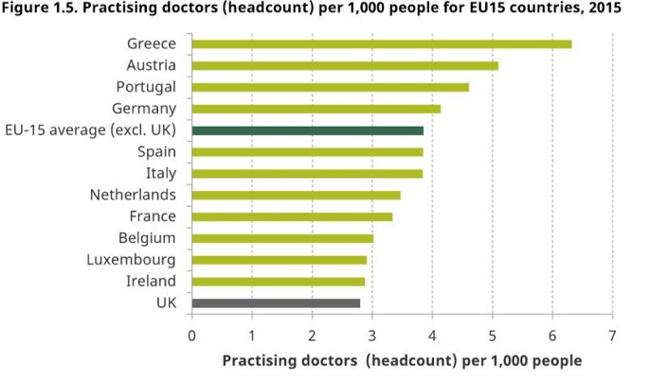

Slide 5
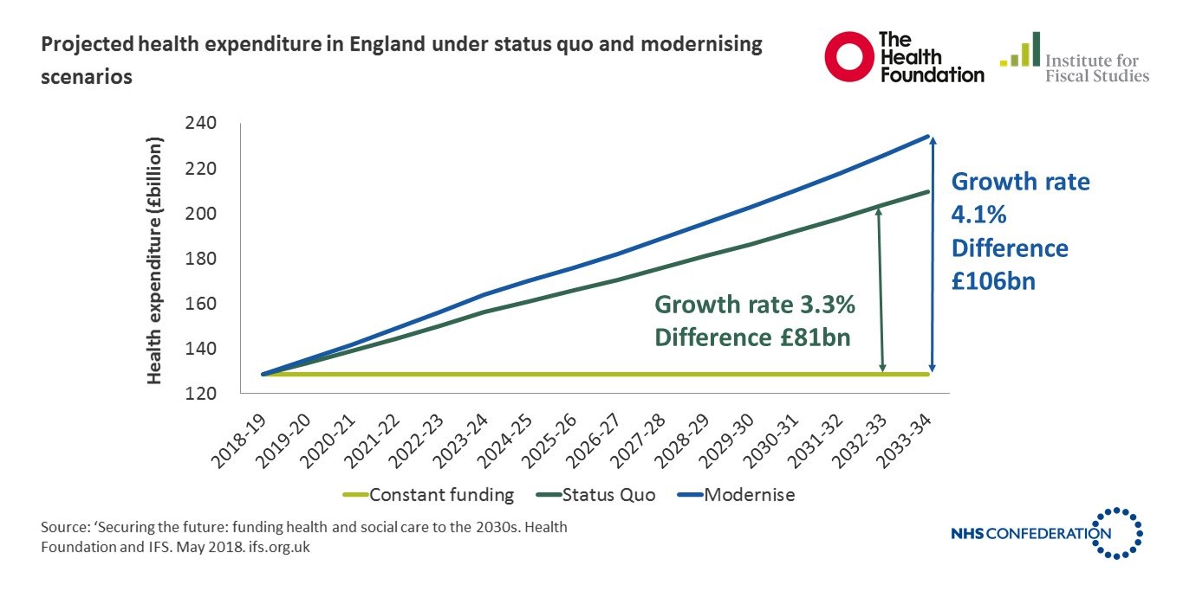

Slide 6

GP Forward View - Published April 2016
£2.4bn by 2020/21
      From £9.6 billion in 2015/16 to over £12 billion by 20/21; 14% real terms increase compared to 8% for rest of NHS
      Includes £500m for extending GP access
£508 million for 5 year Sustainability and Transformation package.
      £56m for practice resilience programme for GPs suffering burnout and stress
      £206m to grow medical and non-medical workforce
      £171m to support practices develop working at scale
  £900m for capital investment
  Action to tackle indemnity costs

Slide 7
Share of NHS funding invested in general practice (England)
Year | % total investment | % excluding dispensed drugs
2004/5 | 10.0% | N/A
2005/6 | 10.4% | N/A
2006/7 | 9.8% | N/A
2007/8 | 9.2% | N/A
2008/9 | 8.7% | 8.0%
2009/10 | 8.5% | 7.8%
2010/11 | 8.3% | 7.7%
2011/12 | 8.2% | 7.6%
2012/13 | 8.0% | 7.5%
2013/14 | 8.0% | 7.4%
2014/15 | 8.1% | 7.5%
2015/16 | 8.3% | 7.7%
2016/17 | 8.5% | 7.9%
NHS budget TDEL, source PESA. GP investment, source HSCIC

Slide 8
GP share of NHS budget – projected change

Slide 9
Funding gap to reach 11% investment target
Investment in general practice (excluding drug reimbursement)

Slide 10
Payments to practices in England 2016/17
(per weighted patient)
GMS - £147.42 (5301 practices)
PMS - £155.06 (2127 practices)
APMS - £224.03 (279 practices)
Average payment - £151.37
Average payment for non-dispensing practice - £142.63 = 57p per day

Slide 11

GP Forward View - workforce
5,000 extra doctors working in general practice by 2020/21
Increase GP training recruitment to 3,250 a year
500 GPs returning through improving Retainer Scheme and Induction and Refresher (I&R) Scheme
£112m (in addition to the existing £31 million) for clinical pharmacists, leading to a further 1500 pharmacists in addition to the current 470 in general practice by 2020 (one pharmacist per 30,000 population).
3,000 practice-based mental health therapists by 2020 – therapist for every 2-3 typically sized practices
£15m for practice nurse development, over £50m reception, admin staff and practice manager development
1000 physician associates in primary care settings by 2020

Slide 12
GP Workforce - 5000 more GPs?
    Current reality (excluding GP trainees):
    September 2015 – March 2018
        Reduction of 112 GPs (0.3%) from 37162 to 37050
        Reduction of 1145 FTE GPs (3.8%) from 29862 to 28717
    December 2016 – December 2017
        Number of FTE GPs rose by 7 (0.02%) to 28874
        Number of FTE consultants rose by 1520 (3.4%) to 46130
        Number of FTE doctors in training rose by 1795 (3.5%) to 52947
        December 2017 – March 2018
        Reduction of 157 FTE GPs (0.5%) from 28874 to 28717
        Increase of 35 GPs (0.1%) from 37015 to 37050
Notes:
Need to caveat these figures as NHS Digital had to estimate data for around 12% of practices in September 2015 and continue to do this for around 5-6% even now. Improvements have been made to the collection for locum data over the last two and a half years too. The trends we are seeing are also a likely consequence of national efforts to improve flexible working for GPs, and they indicate that the 5000 target may in fact be insufficient given GPs’ desire for better work-life balance.
Have excluded GP trainee data because they are supernumerary, the greater service provision burden falls on the qualified GP workforce and workload intensity is a significant contributing factor to qualified GPs reducing their weekly sessions or leaving the profession altogether. The 5000 additional GPs should really be qualified for the target to be met.
Source: General and Personal Medical Services, England: Final 31 December 2017 and Provisional 31 March 2018, experimental statistics, NHS Digital (May 2018) - https://digital.nhs.uk/data-and-information/publications/statistical/general-and-personal-medical-services/final-31-december-2017-and-provisional-31-march-2018-experimental-statistics

Slide 13
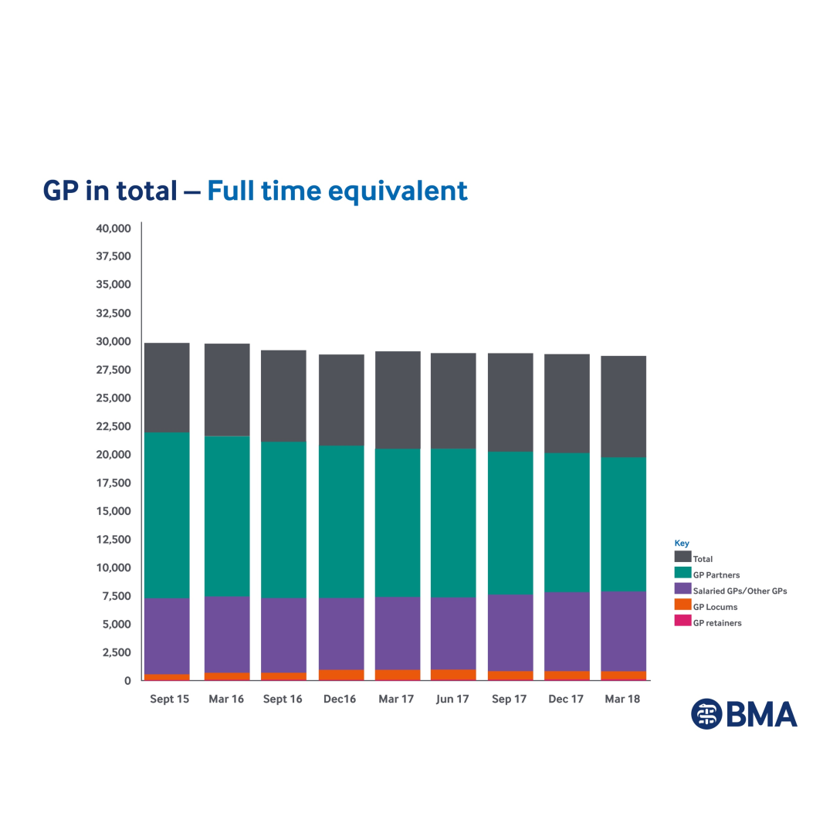
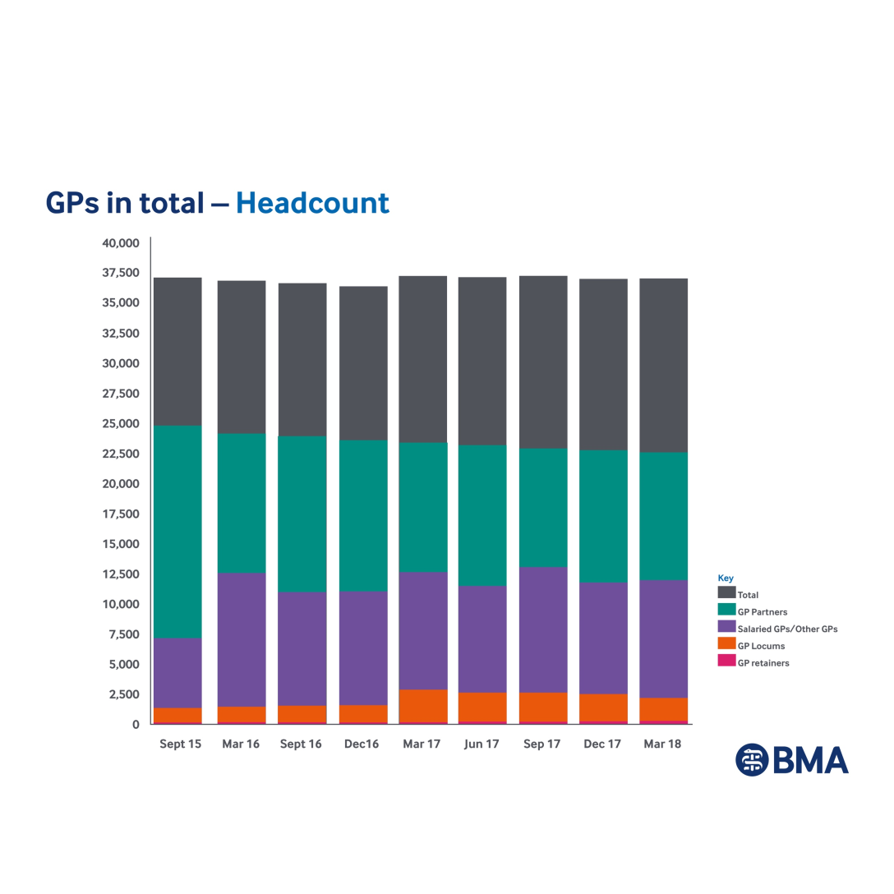
GP workforce – Sept 2015 – March 2018

Slide 14
GP workforce
London trainee survey 2017
Factors affecting job choice
Next career choice:
Salaried GP 47%
Short-term locum 19%
Long-term locum 18%
Other 12%
Partner 4%

Slide 15

Workforce expansion strategy, recurrently funded
Problem: FTE GPs declining, GPs reducing time commitment or leaving, increased role substitution rather than expansion, time-limited funding
Impact: Longer appointment waits, practices unable to recruit, closing lists to new registrations or closing altogether
Solution: Genuine workforce expansion strategy, recurrently funded, flexible working initiatives, international GP recruitment, training grants, better use of funded MDT, promoting general practice positively
Progress: Medical school expansion with GP focus; 256 x £20k targeted enhanced recruitment scheme; improved induction/refresher and retainer schemes; recruiting internationally; clinical pharmacist scheme (1,250 FTE clinical pharmacists across over 3,000 practices by summer 2018) ; plans for first contact practitioners

Slide 16
Other GPFV workforce commitments
Practice manager development
    £6m over 3 years
    NHS England providing funding to support
        subscriptions to the Practice Manager Network
        development of best practice resources for GP practice management
        peer appraisals
        coaching and mentoring
    Networking events have been held around the country
    LMCs involved in planning and delivery
Reception and clerical staff
    Training in active signposting and management of clinical correspondence
    £45 million over five years - £5 million allocated in September 2017, followed by £10 million in July 2018

Slide 17
Managing and reducing workload
The UK population is projected to reach 70 million by mid-2027
    In 2015 11.8m people aged 65+ and 1.5m aged 85+
    By 2020 increased by – 1.1 million 65+, over 300,000 85+
    By 2039 increased by – 9.9 million 75+, 3.6 million 85+
Significant increases in NHS activity across the UK:
    Consultation rates for GPs in England rose by 13.6% between 2007 and 2014 (Oxford University, 2016).
    Consultations numbers increased by more than 15% between 2010/11 and 2014/15 (Kings Fund 2016).
    In Scotland consultations rose by 3.9% from 15.6 million to 16.2 million between 2003 and 2013 (ISD, 2013).
    In Northern Ireland, total general practice consultations rose from 7.2 million in 2003/04 to 12.7 million in 2013/14 (BMA, 2015).
  *There has been no routine public reporting of GP activity data and no standardised national dataset to date – new NHS England data collections are currently in progress in England.

Slide 18
Supporting GPs and practices in crisis
Practice resilience programme
£16 million committed for 2016/17 > £17.2m spent on 1279 practices
£8m available each year until in 2019/20
GP Health Service
Launched January 2017
Case load of over 1200 GP patients

Slide 19

Managing and reducing workload:
Primary-secondary care interface
Changes to the standard hospital contract 2015/16 and 2017, for example:
        hospitals are responsible for providing patients with fit notes
        hospitals to provide discharge summaries within 24 hours
        Hospitals to stop asking GPs to re-refer DNA appointments
Helping practices and LMCs hold CCGs and trusts to account, by providing template letters to report and push back on breaches
Working with NHS England to communicate changes to trusts and patients (eg new patient facing leaflet)
Notes:
NHS standard contract changes:
2016/2017
Referrals - Hospitals to stop asking GPs to re-refer DNA appointments; - Hospital to make internal referrals for related problem and not ask GP to re-refer
Communication with the patient and fit notes - Hospital to follow up investigations and inform patient
Discharge summaries - Discharge summaries within 24 hours
Clinic letters - Clinic letters within 14 days
Drugs - Adequate supply drugs on discharge
2017/2018
Communication with the patient and fit notes - Hospital to put in place arrangements for handling patient queries (from patients and GPs); - Hospital to issue fit notes to patients where needed
Discharge summaries - Discharge summaries from A&E within 24 hrs and direct electronic
transmission from Oct 2018
Clinic letters - Clinic letters within 10 days (April 2017) and 7 days (April 2018) and move to electronic transmission using structured clinical headings (Oct 2018)
Drugs - Hospitals to provide medication following clinic attendance

Slide 20
Managing and reducing workload
Safe working in general practice and ‘black alerts’
Define a safe practice workload and develop an alert system to notify wider health and care system when workloads breach safe limits
Quality first
Expand the current suite of resources with renewed guidance templates
Unresourced work
Reducing unresourced/unfunded workload
Self-care and social prescribing
Create an online resource featuring good practice examples of self-care and social prescribing
NHS England/CCG funding
Use GP access funding, high impact actions, pharmacists and other resources

Slide 21

Retain national core contract for general practice
Problem: Threat of APMS and ACO contracts, doctors unwilling to commit to becoming partners due to uncertainty, impacting recruitment, retention and premises developments with practices handing back contracts
Impact: Threat to quality health service for patients, continuity of care and working with communities long-term, loss of independent advocate, risk of a costlier service that loses the support of the public, directly managed practices
Solution: Ongoing commitment to the national contract and independent contractor status; at-scale models built on the foundation of registered lists and GMS contract; collaborative working across local healthcare systems rather than single responsible body/employer.
Progress: Investment in GMS contract through national negotiations; Secretary of State established review of partnership model; ACO contract guidance

Slide 22
Premises, IT and admin support
Problem: insufficient investment, deterioration in premises, out of date/not fit for purpose, slow IT networks, outsourcing NHS backroom function problems
Impact: practices handing back contracts because of premises problems, lack of space to expand services, fragmented clinical record systems, challenge from new online providers, daily admin issues due to PCSE failings
Solution: IT refresh; recurrent fully funded systems; end paper records; superfast data connections; fully functioning PCSE/back office support systems; increased recurrent investment in GP premises
Progress: PCDs updated; challenging NHS PS and CHP; extension to STDL/VAT/legal fees programme; discussions regarding the replacement of GPSoC; GP2GP implementation progressing; EPS4 testing; premises review.

Slide 23
18/19 contract changes – England
£256m overall investment
Interim 1% pay uplift for GPs and staff and 3% for expenses
Awaiting DDRB review and government recommendation
£60m for indemnity – 16/17 and 17/18 – for principals and salaried GPs
No changes to QOF (apart from uplift for CPI) – review for 2019/20 underway
Uplift to some vacs & imms IoS (£10.06), sickness and paternity payments
e-RS required use by October, or locally agreed switch-off date - £10m
Premises cost directions agreed

Slide 24
18/19 contract changes – England
Premises cost directions
Permit 100% improvement/development grants, with limited liability
Explicit options for owner-occupiers who hand back core contract
The Board can waive grant repayment for leaseholders who hand back core contract
The Board can assign a lease to their designated property body for leaseholders who hand back core contract
Improved process for rent reviews and lease terms will not be varied following a review
Practices will not be at risk of being financially disadvantaged by agreeing to host a third party at the request of the commissioner
“Focus on premises cost directions” guidance document to be released alongside new directions
Commitment to wider premises review

Slide 25
GP contract 2019/20 workstreams - England
State indemnity scheme by April 2019
Partnership review
QOF review
Premises review
Funding formula review
e-RS implementation group

Slide 26
GP at Hand
London based practice-commissioned App for online consultations – plans for regional expansion
Available to any patient in England, but selective outside practice boundary
Rapid increase in patient registrations – 4970 in 2017 to 24,652 by March 2018
Patients not always aware of impact of leaving their current GP to access this service
Undermines principle of registered list and current funding model
Inappropriate use of out of area regulations
Data protection issues and blurring lines between NHS and private services
Demonstrates need to invest in improved IT for all practices

Slide 27
Primary Care Support Services England
Continued poor service during 2 years of operation
Impact on pension statements – and therefore tax payments
Legal template letters (statutory demands) for practices and GPs to use to recoup incorrect payments
National Audit Office review of NHS England’s commissioning of PCSE
BMA “pledge” campaign
  “I pledge my support to the BMA’s campaign for ‘Primary Care Services (PCSE)’ to be delivered in a satisfactory manner to ensure that it will no longer have a negative impact on general practice’s ability to look after the public”.

Slide 28
GDPR
New data protection regulations from May 2018
Key changes for practices:
Compliance must be actively demonstrated and documentation produced on request
More information is required in ‘privacy notices’ for patients
A legal requirement to report certain data breaches
Significantly increased financial penalties for breaches as well as non-compliance
Not charging patients for access to medical records
Designation of Data Protection Officers – practice, locality/federation or CCG?
GPC guidance produced

Slide 29
NHS Digital – Home Office MoU
MoU permitted disclosures by NHS Digital to the Home Office for suspected immigration offences without consideration of the seriousness of the offence
Following BMA lobbying Government position changed
Restricting NHS Digital’s data sharing with the Home Office to the tracing of an individual who is being considered for deportation action having been investigated for, or convicted of, a serious criminal offence, or where they present a risk to the public
Estimated that the change to the MoU will exclude some 95% of current Home Office requests

Slide 30
Data opt-out changes
New data opt-out arrangements from 25 May
Enables patients to choose whether data is used for research and health planning
Existing patient type 2 objections “Dissent from disclosure of personal confidential data by Health and Social Care Information Centre” automatically converted by NHS Digital – patients will receive letter to inform them
Patients wanting to opt-out in future should do so online or telephone, not via their GP
Type 1 objections “Dissent from secondary use of GP patient identifiable data” valid until March 2020 – then consultation will take place on their removal

Slide 31
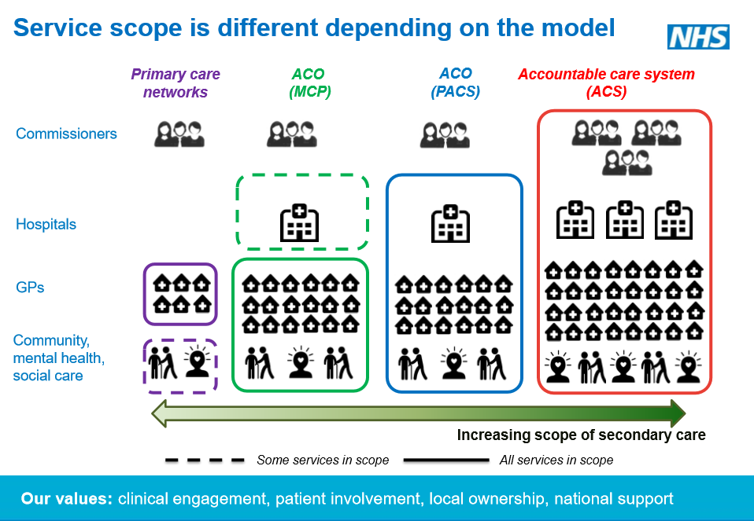
Accountable/integrated care systems & Accountable care organisations
Accountable
Whole population
Single budget
Competitive tender
Salaried and managed service?
Three drivers:
Recognition in England that current system set out in 2012 Health & Social Care Act isn’t working
Could a ‘population health’ approach deliver improved care for patients?
Financial constraints

Slide 32
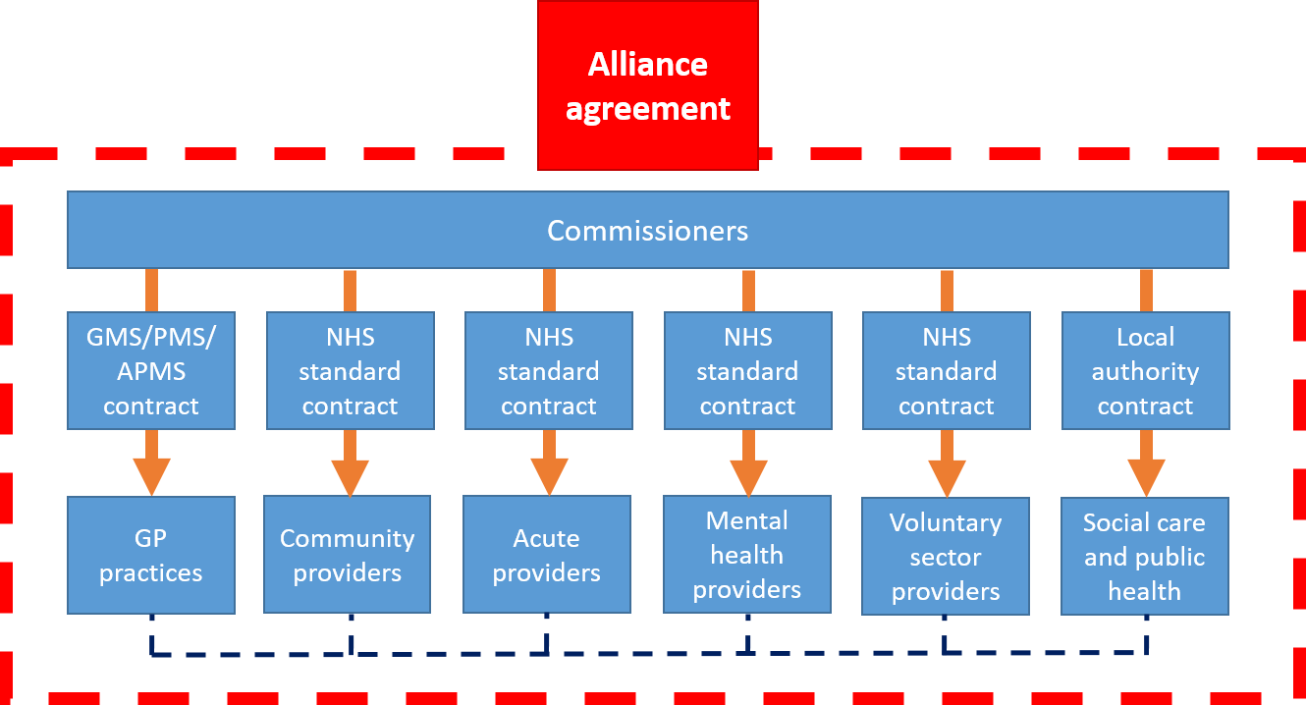
Virtually integrated
All contracts and accountabilities remain in place, but overlaid with an alliance agreement outlining how commissioners and providers will work together to create better integration of services.
Enables providers to work in collaboration under existing contracts.
Essentially an ACS /ICS rather than an ACO

Slide 33
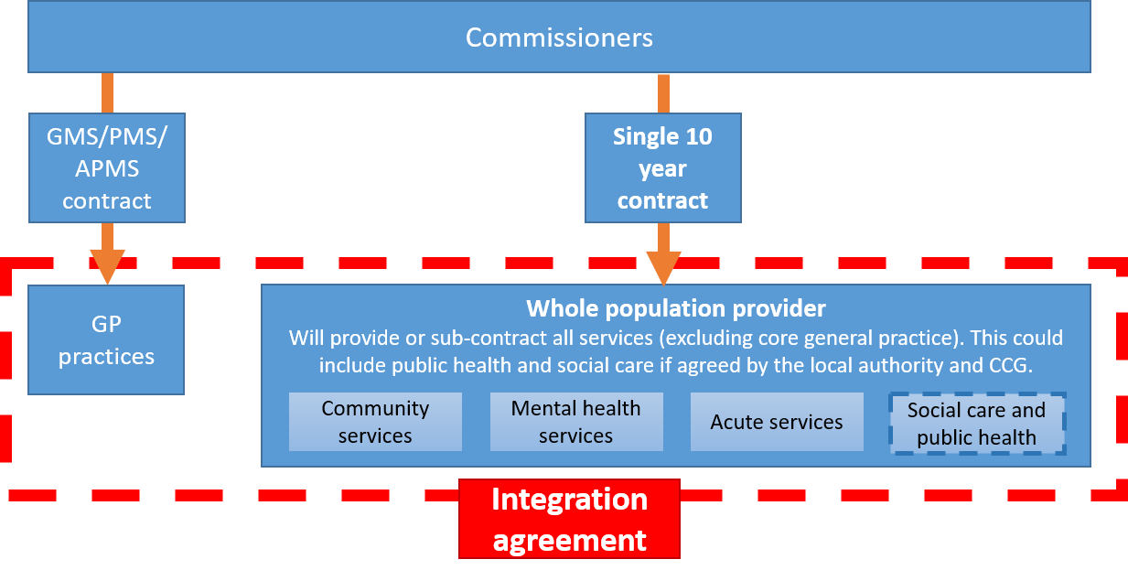
Partially integrated
Single contract held between the commissioners and providers (except core GP services).
Under procurement rules this must be put out to tender.
GP contracts remain in place.
Formal integration agreement between the whole population provider and GP practices to work together.

Slide 34
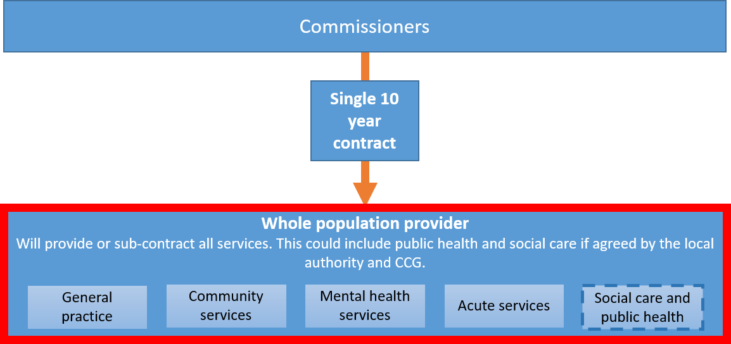
Fully integrated
A single contract between the whole population provider and the commissioners.
Under procurement rules this must be put out to tender.
Provides or sub-contracts all services
An end to GMS/PMS contract

Slide 35
Primary Care Networks
  2018/19 NHS Planning Guidance – “Actively encourage every practice to be part of a local primary care network, so that there is complete geographically contiguous population coverage of primary care networks as far as possible by the end of 2018/19, serving populations of at least 30,000 to 50,000”.
  Expectation to provide extended access to GP services, including at evenings and weekends, for 100% of their population by 1 October 2018
  Need for recurrent management/administration costs funding

Slide 36
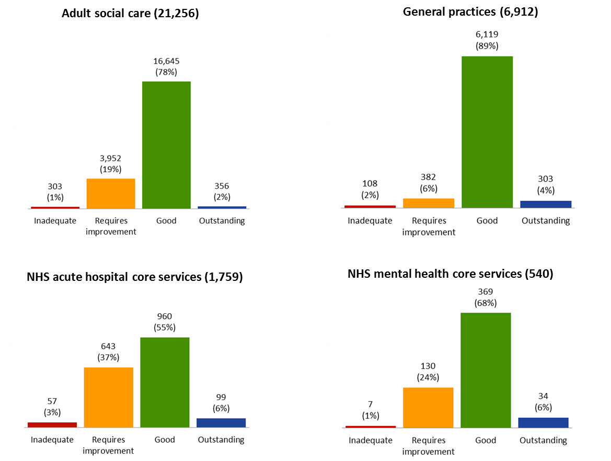
CQC ratings as at 31 July 2017

Slide 37

CQC report – State of Care in General Practice
GPs provide the highest quality care (93% good or outstanding compared to 71% for acute trusts and 74% for NHS core mental health)
Report warned that increased funding in general practice was vital to avoid a significant deterioration in services
General practice is delivering over 90% of all patient contacts on just 7.9% of overall NHS budget

Slide 38

Towards a healthier future for General Practice
Sustained and significant funding investment
More GPs, nurses, clinicians and support staff
Building collaborative teams in each locality
Manage workload enabling quality consultations
Indemnity covered
Premises and IT development
Building on the foundation of a GMS contract
Culture change in the NHS

